Slide 1
Part 8 Routing protocols

Slide 2
Agenda
Routing protocols
Distance Vector routing
Link state routing
Routing in IP networks
Interdomain routing

Slide 3
Question
A distance vector router accepts a route towards destination d on link l if any of three conditions is met. What are these three conditions ?
1. d is not already in the routing table
2. d is already in the routing table, but with a shorter path
3. d is already in the routing table, but with a longer path
4. the sequence number of the distance vector is larger than the previous one
5. d is already in the routing table, but the route was learned from another link than l
6. d is already in the routing table, and the route was learned on link l

Slide 4
Reception of DV
Received(Vector V[],link l)
{ /* received vector from link l */
for each destination=d in V[]
{
if (d isin R[])
{ if ( ((V[d].cost+l.cost) < R[d].cost) OR ( R[d].link == l) )
{ /* better route or change to current route */
R[d].cost=V[d].cost+l.cost;
R[d].link=l;
}
}
else
{ /* new route */
R[d].cost=V[d].cost+l.cost;
R[d].link=l;
}
}

Slide 5
DV sent by R3 to R1 with split horizon?
3
R1
R5
10
R2
R6
9
4
R4
R3
Default link weight is 1

Slide 6
Split horizon
Routing table
A : 0 [ Local ]
D : 1 [South]
B : 3 [South]
C : 3 [South]
E : 2 [South]
Routing table
B : 0 [Local]
A : 3 [South]
C : 1 [East]
E : 1 [South]
D : 2 [South]
Routing table
C : 0 [Local]
E : 1 [South-West]
D : 2 [South-West]
A: 3 [South-West]
B : 1 [West]
A
B
C
Routing table
D : 0 [Local]
A : 1 [North]
E : 1 [East]
C : 2 [East]
B : 2 [East]
A=0
Routing table
E : 0 [Local]
D : 1 [West]
A : 2 [West]
C : 1 [North-East]
B : 1 [North]
D
E
E
A will not pollute D’s routing table

Slide 7
Split horizon (2)
D can also send its distance vector
Routing table
A : 0 [ Local ]
D : 1 [South]
E : ∞
C : ∞
B : ∞
Routing table
B : 0 [Local]
A : 3 [South]
C : 1 [East]
E : 1 [South]
D : 2 [South]
Routing table
C : 0 [Local]
E : 1 [South-West]
D : 2 [South-West]
A: 3 [South-West]
B : 1 [West]
A
B
C
C
Routing table
D : 0 [Local]
A : 1 [North]
E : ∞
C : ∞
B : ∞
D=0;B=∞;C=∞;E=∞
Routing table
E : 0 [Local]
D : 1 [West]
A : 2 [West]
C : 1 [North-East]
B : 1 [North]
D
D
E
E
Does split horizon allows to avoid all counting to infinity problems ?

Slide 8
Limitations of split horizon with poisoning
Routing table
A : 0 [ Local ]
B : ∞ ∞
C : ∞ ∞
E : ∞ ∞
Routing table
B : 0 [Local]
A : 1 [West]
C : 1 [East]
E : 1 [South]
Routing table
C : 0 [Local]
E : 1 [South-West]
A : 2 [West]
B : 1 [West]
A=∞;B=0; C=∞ E=1
A
B
C
C
Routing table
E : 0 [Local]
A : 2 [North]
C : 1 [North-East]
B : 1 [North]
A=∞;B=0; C=1;E=∞
A=2;B=1; C=0;E=∞
E
E

Slide 9
Limitations
Routing table
A : 0 [ Local ]
B : ∞∞
C : ∞ ∞
E : ∞ ∞
Routing table
B : 0 [Local]
A : 1 [West]
C : 1 [East]
E : 1 [South]
Routing table
C : 0 [Local]
E : 1 [South-West]
A : 2 [West]
B : 1 [West]
A
B
C
C
Routing table after B’s vector
E : 0 [Local]
A : ∞
C : 1 [North-East]
B : 1 [North]
Routing table after C’s vector
E : 0 [local]
A : 3 [North-East]
C : 1 [North-East]
B : 1 [North]
A=∞;B=0; C=1;E=∞
A=2;B=1; C=0;E=∞
E
E
E will send its own distance vector
B will discover a new route towards A via E and will advertise it to C
New count to infinity problem

Slide 10
Operational issue
Operation
At each expiration of its 30-sec timer, each router sends its own distance vector and restarts its timer
Problem
After a power failure, all routers might restart at same time and have synchronized timers
Each router will need to process bursts of DV messages
See The Synchronization of Periodic Routing Messages , Floyd, S., and Jacobson, V. IEEE/ACM Transactions on Networking, V.2 N.2, p. 122-136, April 1994.
Notes:
The Synchronization of Periodic Routing Messages , Floyd, S., and Jacobson, V. IEEE/ACM Transactions on Networking, V.2 N.2, p. 122-136, April 1994.

Slide 11
Loop-free routing
What guarantees the fact that packets sent to destination d will eventually reach destination d ?

Slide 12
Agenda
Routing protocols
Distance Vector routing
Link state routing
Routing in IP networks
Interdomain routing

Slide 13
Question
Which of the following informations are contained in a link state packet ?
1. sequence number
2. list of paths to reach known destinations
3. list of pairs (known dest, cost)
4. age of the link state packet
5. clock time
6. list of pairs (neighbor, cost to this neighbor)
7. CRC

Slide 14
Link state packet sent by R4 ?
3
R1
R5
10
R2
R6
9
4
R4
R3
Default link weight is 1

Slide 15
How to set link costs ?
By manual configuration
Based on link bandwidth
By measurements
Only strictly positive link weights

Slide 16
What is the role of
Sequence number in link state packets
How to deal with wrap around ?
Age field in link state packets
CRC in link state packets

Slide 17
Two way connectivity check
Links
A-B, B-A : 1
B-E, E-B : 1
B-C, C-B : 1
E-D, D-E : 1
E-C, C-E : 1
A-D, D-A : 1
LSPs
E-0 [D:1];[B:1];[C:1]
A-0 [D:1];[B:1]
B-0 [A:1] [C:1] [E:1]
C-0 [B:1] [E:1]
D-0 [A:1] [E:1]
Links
A-B, B-A : 1
B-E, E-B : 1
B-C, C-B : 1
E-D, D-E : 1
E-C, C-E : 1
A-D, D-A : 1
LSPs
E-0 [D:1];[B:1];[C:1]
A-0 [D:1];[B:1]
B-0 [A:1] [C:1] [E:1]
C-0 [B:1] [E:1]
D-0 [A:1] [E:1]
Links
A-B, B-A : 1
B-E, E-B : 1
B-C, C-B : 1
E-D, D-E : 1
E-C, C-E : 1
A-D, D-A : 1
LSPs
E-0 [D:1];[B:1];[C:1]
A-0 [D:1];[B:1]
B-0 [A:1] [C:1] [E:1]
C-0 [B:1] [E:1]
D-0 [A:1] [E:1]
LSPs
E-0 [D:1];[B:1];[C:1]
A-0 [D:1];[B:1]
B-0 [A:1] [C:1] [E:1]
C-0 [B:1] [E:1]
D-0 [A:1] [E:1]
A
B
C
C
D
LSP : E-1 [D:1];[C:1]
Links
A-B, B-A : 1
B-E, E-B : 1
B-C, C-B : 1
E-D, D-E : 1
E-C, C-E : 1
A-D, D-A : 1
D
E
E
LSP : E-1 [D:1];[C:1]
LSPs
E-1 [D:1];[C:1]
A-0 [D:1];[B:1]
B-0 [A:1] [C:1] [E:1]
C-0 [B:1] [E:1]
D-0 [A:1] [E:1]
Links
A-B, B-A : 1
B-E, E-B : 1
B-C, C-B : 1
E-D, D-E : 1
E-C, C-E : 1
A-D, D-A : 1
A link is only considered useable only if both directions have been advertised

Slide 18
Transient problems when a link fails
A's FIB
B : East
C : South
D : East
B's FIB
A : West
C : West
D : South
A
B
C
100
D
C's FIB
A : North
B : North
D : North
D's FIB
A : North
B : North
C : North
A and B are not yet aware of failure
Packets will be lost

Slide 19
A detects the failure
A's FIB
B : East
C : South
D : East
B's FIB
A : West
C : West
D : South
A
B
C
100
D
C's FIB
A : North
B : North
D : North
D's FIB
A : North
B : North
C : North
B not yet aware of failure
A cannot reach B/D
Packets continue to be lost

Slide 20
A recomputes Dijkstra and sends its LSP
A's FIB
B : South
C : South
D : South
B's FIB
A : West
C : West
D : South
A
B
A:1 C=1
C
100
D
C's FIB
A : North
B : North
D : North
D's FIB
A : North
B : North
C : North
B not yet aware of failure
A loops towards B/D
Packets continue to be lost

Slide 21
B detects the failure
A's FIB
B : South
C : South
D : South
B's FIB
A : West
C : West
D : South
A
B
A:1 C=1
C
100
D
C's FIB
A : North
B : North
D : North
D's FIB
A : North
B : North
C : North
B cannot reach A/C
A loops towards B/D
Packets continue to be lost

Slide 22
B recomputes Dijkstra and sends its LSP
A's FIB
B : South
C : South
D : South
B's FIB
A : South
C : South
D : South
A
B
B:1 D=1
C
100
D
C's FIB
A : North
B : North
D : North
D's FIB
A : North
B : North
C : North
B cannot reach A/C
A loops towards B/D
Packets continue to be lost

Slide 23
C recomputes Dijkstra
A's FIB
B : South
C : South
D : South
B's FIB
A : South
C : South
D : South
A
B
C
100
D
C's FIB
A : North
B : East
D : East
D's FIB
A : North
B : North
C : North
B loops towards A/C
A can reach everyone
Packets continue to be lost

Slide 24
D recomputes Dijkstra
A's FIB
B : South
C : South
D : South
B's FIB
A : South
C : South
D : South
A
B
C
100
D
C's FIB
A : North
B : East
D : East
D's FIB
A : West
B : North
C : West
B can reach everyone
A can reach everyone
Network has been updated

Slide 25
Router failures
Planned failures
Router reboot to upgrade OS
Sudden failure
due to power outage, software or hardware crash

Slide 26
Comparing routing protocols
Neighbour detection
Detecting link failures
Detecting router failures
Link weights
What information is distributed ?
How often ?
How are forwarding tables built ?

Slide 27
Agenda
Routing protocols
Distance Vector routing
Link state routing
Routing in IP networks
Interdomain routing

Slide 28
Internet routing
Interior Gateway Protocol (IGP)
Routing of IP packets inside each domain
Only knows topology of its domain
Domain4
Domain2
Domain1
Domain3
Exterior Gateway Protocol (EGP)
Routing of IP packets between domains
Each domain is considered as a blackbox

Slide 29
Intradomain routing
Goal
Allow routers to transmit IP packets along the best path towards their destination
best usually means the shortest path
Shortest measured in seconds or hops
sometimes best means the less loaded path
Alternate routes in case of failures
Behavior
All routers exchange routing information

Slide 30
Intradomain routing
Static routing
Only useful in very small domains
Distance vector routing
Routing Information Protocol (RIP)
Still widely used in small domains despite its limitations
Link-state routing
Open Shortest Path First (OSPF)
Widely used in enterprise networks
Intermediate System- Intermediate-System (IS-IS)
Widely used by ISPs

Slide 31
Agenda
Routing Protocols
Routing in IP networks
Routing organization
RIP and OSPF
Interdomain routing

Slide 32
RIP
Distance vector
default period : 30 seconds (with jitter)
distance vector is multicasted in UDP message to all RIP routers in local subnets
Optional extension :
send distance vector after each change
but some links flaps...
send distance vector if routing table changed and did not send another vector within the last 5 seconds
Notes:
RFC2453 RIP Version 2. G. Malkin. November 1998
Gary Malkin, RIP : an intra-domain routing protocol, Addison-Wesley, 2002

Slide 33
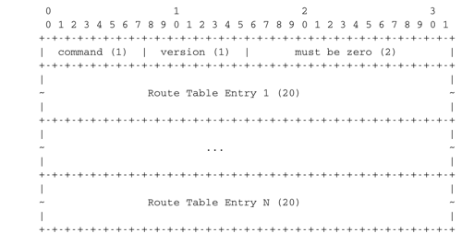
RIP : message format
RIP messages are sent over UDP
port 520

Slide 34
RIP : Route Entries

Slide 35
OSPF
Standard link-state routing protocol for TCP/IP networks (IS-IS in ISP networks)
Builds upon link-state routing with some extensions
Hierarchical routing with areas
Designated routers on subnets
Equal Cost Multipath

Slide 36
OSPF
Operation
HELLO packets to discover neighbors
Update of routing tables
Link state packets
acknowledgements, sequence numbers, age
periodic transmission/ link changes
Database description
Link state Request
used when a router boots to request link state packets from neighbors
Notes:
RFC2328 OSPF Version 2. J. Moy. April 1998.
J. Moy, OSPF: Anatomy of an Internet Routing Protocol, Addison Wesley, 1998

Slide 37
OSPF details
R
R
R
R
2001:db8:1::A/48
2001:db8:1::B/48
2001:db8:1::C/48
2001:db8:1::D/48
2001:db8:1::B/48
2001:db8:1::A/48
2001:db8:1::C/48
2001:db8:1::D/48

Slide 38
OSPF details (2)
R
R
R
R
2001:db8:1::A/48
2001:db8:1::B/48
2001:db8:1::C/48
2001:db8:1::D/48
2001:db8:1::B/48
LAN
2001:db8:1::A/48
2001:db8:1::C/48
2001:db8:1::D/48

Slide 39
OSPF details (3)
Divide network in areas
Backbone area : network backbone
all routers connected to two or more areas belong to the backbone area
All non-backbone areas must be attached to the backbone area
at least one router inside each area must be attached to the backbone
OSPF routing must allow any router to send packets to any other router

Slide 40
OSPF details (4)
R1
R5
C
Stub AREA 1
Inside each non-backbone area
Routers exchange link state packets to distribute the topology of the area
Routers do not know the topology of other areas, but each router knows how to reach the backbone area
D
E
R3
R4
RA
AREA 0
RC
Inside backbone area
Routers exchange link state packets to distribute the topology of the backbone area
Each router knows how to reach the other areas and distance vectors are used to distribute inter-area routes
RB
R7
R8
AREA 2
D
E
R9
R10

Slide 41
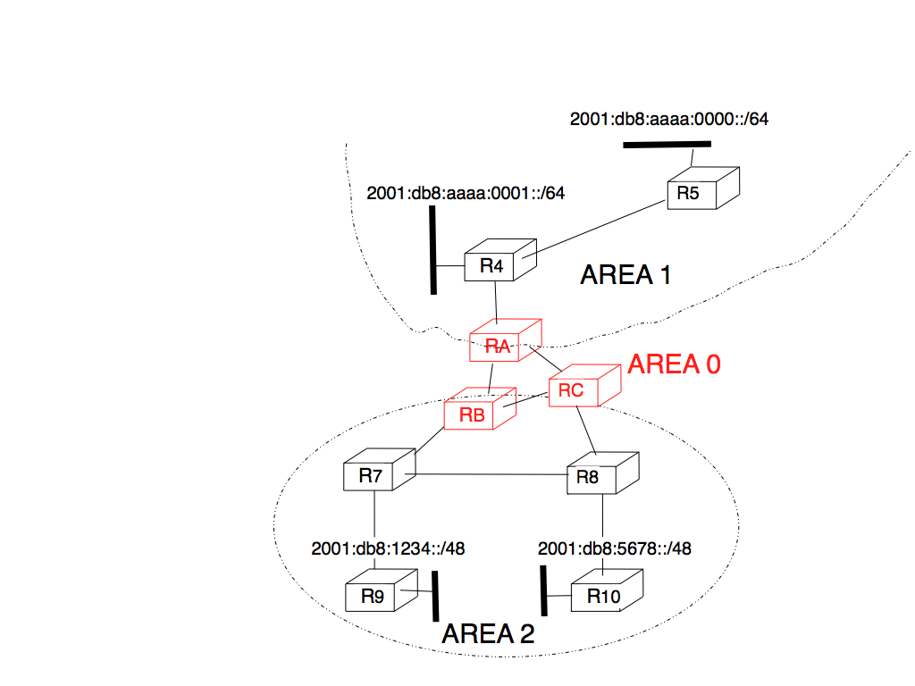
OSPF areas

Slide 42
Equal Cost Multipath
R3
R4
R7
R1
R2
R5
R8
RD
R6
R9

Slide 43
Load balancing techniques
Per-packet load balancing
When a router has several equal cost paths to a destination, it sends packets over the different paths using round-robin
Advantage : fair distribution
Drawback: can cause reordering for TCP

Slide 44
Load balancing techniques
Per-flow load balancing
Router identifies layer-4 flows
Hash(IP_{src}, IP_{dest}, Port_{src}, Port_{dest})
Each flow assigned to path based on hash
Advantage : no reordering
Drawback: if elephant flows are sent along same path, unfairness
How to ensure that all the packets from a single TCP connection follow the same path to avoid reordering ?

Slide 45
Agenda
Routing Protocols
Routing in IP networks
Interdomain routing
Routing policies
BGP basics

Slide 46
Interdomain routing
Goals
Allow to transmit IP packets along the best path towards their destination through several transit domains while considering their routing policies of each domain without knowing their detailed topology
From an interdomain viewpoint, best path often means cheapest path
Each domain is free to specify inside its routing policy the domains for which it agrees to provide a transit service and the method it uses to select the best path to reach each destination

Slide 47
Interdomain links
Private link
Usually, a leased line between two routers belonging to the two connected domains
R1
R2
DomainA
DomainB
Notes:
For more information on the organization of the Internet, see :
G. Huston, Peerings and settlements, Internet Protocol Journal, Vol. 2, N1 et 2, 1999, http://www.cisco.com/warp/public/759/ipj_Volume2.html
For more information on interconnection points or Internet exchanges, see :
http://www.euro-ix.net/
http://www.ripe.net/ripe/wg/eix/index.html
http://www.ep.net/ep-main.html

Slide 48
Interconnection exchanges
How to efficiently connect several domains together ?
R2
R3
Physical link
Interdomain link
R1
R4

Slide 49
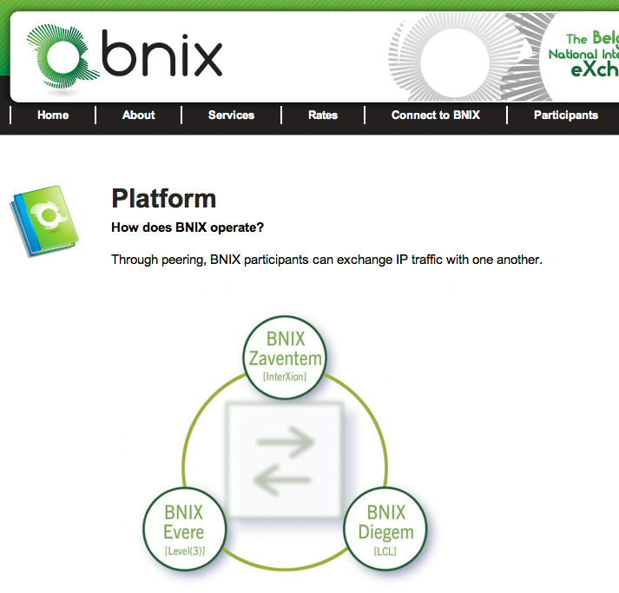
An Internet exchange point

Slide 50
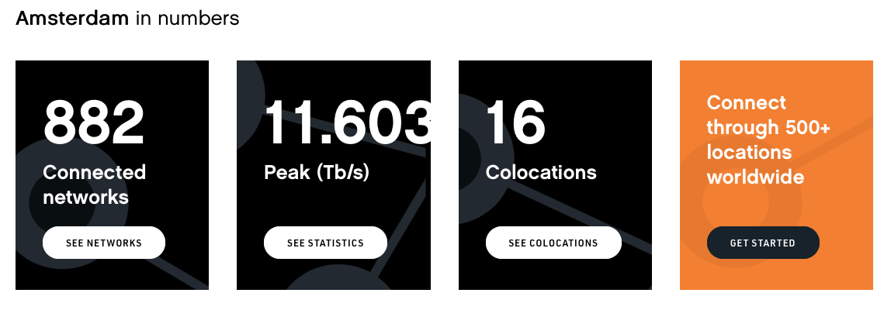
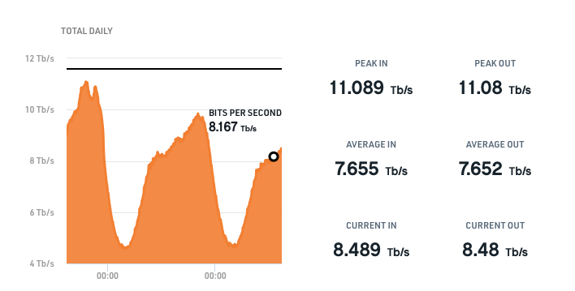
AMS-IX
Largest IX in the world

Slide 51
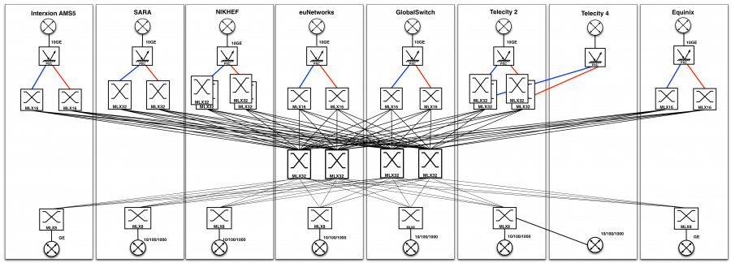
AMS-IX

Slide 52
Routing policies
In theory BGP allows each domain to define its own routing policy...
In practice there are two common policies
customer-provider peering
Customer c buys Internet connectivity from provider P
shared-cost peering
Domains x and y agree to exchange packets without any payment

Slide 53
Customer-provider peering
AS1
AS2
$
$
$
Customer Provider
AS3
AS4
$
$
Principle
Customer sends to its provider internal routes and routes learned from its customers
Provider sends to its customers all known routes
AS7
Notes:
On link AS7-AS4
AS7 advertises its own routes to AS4
AS4 advertises to AS7 the routes that allow to reach the entire Internet
On link AS4-AS2
AS4 advertises its own routes and the routes belonging to AS7
AS2 advertises the routes that allow to reach the entire Internet

Slide 54
Question
AS1
AS2
$
$
$
Customer Provider
AS3
AS4
$
Each AS advertises one prefix (p1 for AS1,...)
Which prefixes are advertised by AS4 to AS2 ?
$
AS7
Which prefixes are advertised by AS4 to AS7 ?

Slide 55
Shared-cost peering
AS1
AS2
$
$
$
Shared-cost
Customer-provider
AS3
AS4
$
$
Principle
PeerX sends to PeerY its internal routes and the routes learned from its own customers
PeerY sends to PeerX its internal routes and the routes learned from its own customers
AS7
Notes:
On link AS3-AS4
AS3 advertises its internal routes
AS4 advertises its internal routes and the routes learned from AS7 (its customer)
On link AS1-AS2
AS1 advertises its internal routes and the routes received from AS3 and AS4 (its customers)
AS2 advertises its internal routes and the routes learned from AS74(its customer)

Slide 56
Customer-provider peering : example
AS1
AS2
$
$
$
AS3
AS4
Customer-provider
$
$
AS7
AS7-AS4 peering link
AS7 advertises its routes to AS4
AS4 advertises to AS7 all its routes
AS4-AS2 peering link
AS4 advertises its own routes et those of its customers (AS7)
AS2 advertises to AS2 all known routes

Slide 57
Question
AS1
AS2
$
$
$
Shared-cost
Each AS advertises one prefix (p1 for AS1,...)
Which prefixes are advertised by AS4 to AS3 ?
Customer-provider
AS3
AS4
$
$
AS7
Which prefixes are advertised by AS2 to AS1 ?

Slide 58
Shared cost peerings
AS3
AS1
AS2
$
$
$
Shared-cost
Each AS advertises one prefix (p1 for AS1,...)
Which prefixes are advertised by AS3 to AS1 ?
AS5
Customer-provider
AS4
$
$
AS7
Which prefixes are advertised by AS1 to AS2 ?

Slide 59
Shared-cost peering : example
AS1
AS2
$
$
$
Shared-cost
AS3-AS4 peering link
AS3 advertises its own routes
AS4 advertises its own routes and those received from its clients (AS7)
AS1-AS2 peering link
AS1 advertises its own routes and those received from its clients (AS3 and AS4)
AS1 advertises its own routes and those received from its clients (AS4)
AS3
AS4
Customer-provider
$
$
AS7

Slide 60
Routing policies
A domain specifies its routing policy by defining on each BGP router two sets of filters for each peer
Import filter
Specifies which routes can be accepted by the router among all the received routes from a given peer
Export filter
Specifies which routes can be advertised by the router to a given peer
Notes:
RFC 2622 Routing Policy Specification Language (RPSL). C. Alaettinoglu, C.
Villamizar, E. Gerich, D. Kessens, D. Meyer, T. Bates, D. Karrenberg,
M. Terpstra. June 1999.
RFC 2650 Using RPSL in Practice. D. Meyer, J. Schmitz, C. Orange, M.
Prior, C. Alaettinoglu. August 1999.
Internet Routing Registries contain the routing policies of various ISPs, see :
http://www.ripe.net/ripencc/pub-services/whois.html
http://www.arin.net/whois/index.html
http://www.apnic.net/apnic-bin/whois.pl

Slide 61
Simple example with RPSL
AS1
AS2
$
$
$
Shared-cost
Customer-provider
AS3
AS4
$
$
Import policy for AS4
Import: from AS3 accept AS3
import: from AS7 accept AS7
import: from AS1 accept ANY
import: from AS2 accept ANY
AS7
Import policy for AS7
Import: from AS4 accept ANY
Export policy for AS4
export: to AS4 announce AS7
Export policy for AS4
export: to AS3 announce AS4 AS7
export: to AS7 announce ANY
export: to AS1 announce AS4 AS7
export: to AS2 announce AS4 AS7

Slide 62
Interdomain paths
AS1
AS2
$
$
$
Shared-cost
Customer-provider
AS3
AS4
$
Each AS advertises one prefix (p1 for AS1,...)
Which path will be used from AS7 to AS2 ?
$
AS7
Which path will be used from AS3 to AS2 ?

Slide 63
Agenda
Routing in IP networks
Interdomain routing
Routing policies
eBGP basics
BGP convergence

Slide 64
Border Gateway Protocol
Path vector protocol
BGP router advertises its best route to each destination
prefix: 2001:db8:1/48 ASPath: AS1
AS5
2001:db8:1/48
AS1
AS2
prefix: 2001:db8:1/48 ASPath: ::AS2:AS4:AS1
prefix:2001:db8:1/48
ASPath: AS1
prefix: 2001:db8:1/48
ASPath: AS4:AS1
AS4
... with incremental updates

Slide 65
BGP : Principles
Principles
BGP relies on the incremental exchange of path vectors
BGP session established over TCP connection between peers
AS3
R1
BGP
session
Each peer sends all its active routes
BGP Msgs
R2
AS4
As long as the BGP session remains up
Incrementally update BGP routing tables

Slide 66
BGP basics
2 types of BGP messages
UPDATE (path vector)
advertises a route towards one prefix
Destination address/prefix
Interdomain path (AS-Path)
Nexthop
WITHDRAW
a previously announced route is not reachable anymore
Unreachable destination address/prefix

Slide 67
BGP router
BGP Adj-RIB-In
BGP Loc-RIB
Peer[N]
All
acceptable routes
BGP Adj-RIB-Out
BGP Msgs from Peer[N]
BGP Msgs to Peer[N]
Peer[1]
Peer[N]
BGP Msgs from Peer[1]
Import filter
Attribute
manipulation
BGP Decision Process
Peer[1]
Export filter
Attribute
manipulation
BGP Msgs to Peer[1]
Import filter(Peer[i])
Determines which BGM Msgs are acceptable from Peer[i]
One best
route to each
destination
Export filter(Peer[i])
Determines which routes can be sent to Peer[i]
BGP Routing Information Base
Contains all the acceptable routes learned from all Peers + internal routes
BGP decision process selects the best route towards each destination

Slide 68
Example
UPDATE
prefix: 2001:db8:12/48,
NextHop:R1
ASPath: AS10
UPDATE
prefix: 2001:db8:12/48,
NextHop:R2
ASPath: AS20:AS10
AS10
AS30
AS20
R1
BGP
R2
R3
2001:db8:12/48
BGP
BGP
UPDATE
prefix: 2001:db8:12/48,
NextHop:R1
ASPath: AS10
UPDATE
prefix: 2001:db8:12/48,
NextHop:R4
ASPath: AS40:AS10
R4
AS40
What happens if link AS10-AS20 goes down ?
What happens if link AS10-AS40 goes down ?
Notes:
If link AS10-AS20 goes down, AS20 will not consider anymore the path learned from AS10. It will thus remove this path from its routing table and will instead select the path learned from AS40. This will force AS20 to send the following UPDATE to AS30 :

Slide 69
How to prefer some routes over others ?
RA
AS2
RB
Backup: 2Mbps
Primary: 34Mbps
R1
AS1

Slide 70
How to prefer some routes over others
Limitations
RA
RB
AS3
AS2
R3
Expensive
R5
AS5
AS1
Cheap
R2
AS4
R1

Slide 71
BGP router
BGP RIB
All
acceptable routes
Peer[N]
Peer[N]
BGP Msgs from Peer[N]
BGP Msgs to Peer[N]
Peer[1]
BGP Decision Process
Peer[1]
Import filter
Attribute
manipulation
Export filter
Attribute
manipulation
BGP Msgs from Peer[1]
BGP Msgs to Peer[1]
One best
route to each
destination
Import filter
Selection of acceptable routes
Addition of local-pref attribute inside received BGP Msg
Normal quality route : local-pref=100
Better than normal route :local-pref=200
Worse than normal route :local-pref=50
Simplified BGP Decision Process
Select routes with highest local-pref
If there are several routes, choose routes with the shortest ASPath
If there are still several routes tie-breaking rule

Slide 72
BGP session
Session establishment
def initialize_BGP_session( RemoteAS, RemoteIP):
# Initialize and start BGP session
# Send BGP OPEN Message to RemoteIP on port 179
# Follow BGP state machine
# advertise local routes and routes learned from peers*/
for d in BGPLocRIB :
B=build_BGP_Update(d)
S=Apply_Export_Filter(RemoteAS,B)
if (S != None) :
send_Update(S,RemoteAS,RemoteIP)
# entire RIB has been sent
# new Updates will be sent to reflect local or distant
# changes in routers
Why ?

Slide 73
Simple export filter
Why ?
def apply_export_filter(RemoteAS, BGPMsg) :
# check if RemoteAS already received route
if RemoteAS is BGPMsg.ASPath :
BGPMsg=None
# Many additional export policies can be configured :
# Accept or refuse the BGPMsg
# Modify selected attributes inside BGPMsg
return BGPMsg

Slide 74
Simple import filter
def apply_import_filter(RemoteAS, BGPMsg):
if MysAS in BGPMsg.ASPath :
BGPMsg=None
# Many additional import policies can be configured :
# Accept or refuse the BGPMsg
# Modify selected attributes inside BGPMsg
return BGPMsg

Slide 75
Processing UPDATE
def Recvd_BGPMsg(Msg, RemoteAS) :
B=apply_import_filer(Msg,RemoteAS)
if (B== None): # Msg not acceptable
return
if IsUPDATE(Msg):
Old_Route=BestRoute(Msg.prefix)
Insert_in_RIB(Msg)
Run_Decision_Process(RIB)
if (BestRoute(Msg.prefix) != Old_Route) :
# best route changed
B=build_BGP_Message(Msg.prefix);
S=apply_export_filter(RemoteAS,B);
if (S!=None) : # announce best route
send_UPDATE(S,RemoteAS,RemoteIP);
else if (Old_Route != None) :
send_WITHDRAW(Msg.prefix,RemoteAS, RemoteIP)

Slide 76
Processing WITHDRAW
else : # Msg is WITHDRAW
Old_Route=BestRoute(Msg.prefix)
Remove_from_RIB(Msg)
Run_Decision_Process(RIB)
if (Best_Route(Msg.prefix) !=Old_Route):
# best route changed
B=build_BGP_Message(Msg.prefix)
S=apply_export_filter(RemoteAS,B)
if (S != None) : # still one best route towards Msg.prefix
send_UPDATE(S,RemoteAS, RemoteIP);
else if(Old_Route != None) : # No best route anymore
send_WITHDRAW(Msg.prefix,RemoteAS,RemoteIP);

Slide 77
Simple example
AS2
AS1
AS3
AS4
AS1 announces one prefix, p
No routing policies
AS5
How many routes in AS5?
How many routes in AS4?
Notes:
Due to the utilization of the local-pref attribute, some paths on the Internet are longer than their optimum length, see :
Lixin Gao and Feng Wang , The Extent of AS Path Inflation by Routing Policies, GlobalInternet 2002

Slide 78
Simple example
p AS1
AS2
p AS2:AS1
RIB
p AS2:AS1 (best)
p AS4:AS1
AS1
AS3
p AS4:AS1
p AS3:AS2:AS1
p AS1
AS4
AS1 announces one prefix, p
No routing policies
RIB
p AS3:AS2:AS1
p AS1 (best)
Notes:
Due to the utilization of the local-pref attribute, some paths on the Internet are longer than their optimum length, see :
Lixin Gao and Feng Wang , The Extent of AS Path Inflation by Routing Policies, GlobalInternet 2002

Slide 79
Another example
p AS1
AS2
p AS2:AS1
AS1
AS3
AS1 announces one prefix, p
No routing policies
Links are activated in the following order
AS1-AS2, AS3-AS4, AS2-AS3, AS1-AS3
p AS1
p AS3:AS2:AS1
AS4
What will AS3 do when receiving this update ?
Notes:
Due to the utilization of the local-pref attribute, some paths on the Internet are longer than their optimum length, see :
Lixin Gao and Feng Wang , The Extent of AS Path Inflation by Routing Policies, GlobalInternet 2002

Slide 80
How to prefer routes ?
RA
AS2
RB
Backup: 2Mbps
Primary: 34Mbps
R1
AS1
RPSL-like policy for AS1
aut-num: AS1
import: from AS2 RA at R1 set localpref=100;
from AS2 RB at R1 set localpref=200;
accept ANY
export: to AS2 RA at R1 announce AS1
to AS2 RB at R1 announce AS1
RPSL-like policy for AS2
aut-num: AS2
import: from AS1 R1 at RA set localpref=100;
from AS1 R1 at RB set localpref=200;
accept AS1
export: to AS1 R1 at RA announce ANY
to AS2 R1 at RB announce ANY
Notes:
Note that in RPSL, the set localpref construct does not exist. It is replaced with action preference=x. Unfortunately, in RPSL the routes with the lowest preference are preferred. RPSL uses thus the opposite of local-pref....

Slide 81
How to prefer routes ?
RA
RB
AS3
AS2
R3
Expensive
R5
AS5
AS1
Cheap
R2
AS4
R1
RPSL policy for AS1
aut-num: AS1
import: from AS2 RA at R1 set localpref=100;
from AS4 R2 at R1 set localpref=200;
accept ANY
export: to AS2 RA at R1 announce AS1
to AS4 R2 at R1 announce AS1
AS1 will prefer to send over cheap link
But the flow of the packets destined to AS1 will depend on the routing policy of the other domains

Slide 82
Agenda
Routing in IP networks
Interdomain routing
Routing policies
eBGP basics
BGP convergence

Slide 83
Limitations of local-pref
In theory
Each domain is free to define its order of preference for the routes learned from external peers
How to reach 2001:db8:1/48 from AS3 and AS4 ?
2001:db8:1/48
AS1
Preferred paths for AS3
1. AS4:AS1
2. AS1
Preferred paths for AS4
1. AS3:AS1
2. AS1
AS3
AS4

Slide 84
Limitations of local-pref
AS1 sends its UPDATE messages ...
2001:db8:1/48
UPDATE
P: 2001:db8:1/48
ASPath: AS1
UPDATE
P: 2001:db8:1/48
ASPath: AS1
AS1
AS3
AS4
Preferred paths for AS4
1. AS3:AS1
2. AS1
Preferred paths for AS3
1. AS4:AS1
2. AS1
Routing table for AS3
2001:db8:1/48 ASPath: AS1 (best)
Routing table for AS4
2001:db8:1/48 ASPath: AS1 (best)

Slide 85
Limitations of local-pref
First possibility
AS3 sends its UPDATE first...
2001:db8:1/48
AS1
Preferred paths for AS4
1. AS3:AS1
2. AS1
Preferred paths for AS3
1. AS4:AS1
2. AS1
AS3
AS4
Routing table for AS3
2001:db8:1/48 ASPath: AS1 (best)
Routing table for AS4
2001:db8:1/48 ASPath: AS1
2001:db8:1/48 ASPath:AS3:AS1 (best)
UPDATE
P: 2001:db8:1/48
ASPath: AS3:AS1
Stable route assignment

Slide 86
Limitations of local-pref
AS4 sends its UPDATE first...
2001:db8:1/48
AS1
Preferred paths for AS4
1. AS3:AS1
2. AS1
Preferred paths for AS3
1. AS4:AS1
2. AS1
AS3
AS4
Routing table for AS3
2001:db8:1/48 ASPath: AS1
2001:db8:1/48 ASPath: AS4:AS1 (best)
Routing table for AS4
2001:db8:1/48 ASPath: AS1 (best)
UPDATE
Prefix: 2001:db8:1/48
ASPath: AS4:AS1
Another (but different) stable route assignment

Slide 87
Limitations of local-pref
AS3 and AS4 send their UPDATE together...
2001:db8:1/48
AS1
Preferred paths for AS4
1. AS3:AS1
2. AS1
Preferred paths for AS3
1. AS4:AS1
2. AS1
AS3
AS4
UPDATE
P: 2001:db8:1/48
ASPath: AS3:AS1
UPDATE
P: 2001:db8:1/48 ASPath: AS4:AS1
AS3 prefers indirect path -> withdraw
AS4 prefers indirect path -> withdraw

Slide 88
Limitations of local-pref
AS3 and AS4 send their UPDATE together...
2001:db8:1/48
Preferred paths for AS3
1. AS4:AS1
2. AS1
Preferred paths for AS4
1. AS3:AS1
2. AS1
AS1
AS3
AS4
WITHDRAW
P: 2001:db8:1/48
WITHDRAW
P: 2001:db8:1/48
AS3 : indirect route is not available anymore
AS3 will reannounce its direct route...
AS4 : indirect route is not available anymore
AS4 will reannounce its direct route...

Slide 89
More limitations local pref
Unfortunately, interdomain routing may not converge at all in some cases...
How to reach a destination inside AS0 in this case ?
Preferred paths for AS1
1. AS3:AS0
2. other paths
AS1
Preferred paths for AS4
1. AS1:AS0
2. other paths
Preferred paths for AS3
1. AS4:AS0
2. other paths
AS0
AS3
AS4
Notes:
In practice, the exchange of BGP UPDATE messages will cease due to the utilization of timers by BGP routers and the routing will stabilize on one of the two stable route assignments.

Slide 90
Simple example
Shared-cost
$
AS2
Customer-provider
AS1 announces one prefix, p
$
AS1
AS3
Notes:
Due to the utilization of the local-pref attribute, some paths on the Internet are longer than their optimum length, see :
Lixin Gao and Feng Wang , The Extent of AS Path Inflation by Routing Policies, GlobalInternet 2002

Slide 91
Simple example
Shared-cost
$
Customer-provider
AS2
$
AS1
AS3
$
$
AS4
AS1 announces one prefix, p
AS5
Notes:
Due to the utilization of the local-pref attribute, some paths on the Internet are longer than their optimum length, see :
Lixin Gao and Feng Wang , The Extent of AS Path Inflation by Routing Policies, GlobalInternet 2002

Slide 92
Simple example
Shared-cost
$
Customer-provider
AS2
$
AS1
AS3
$
$
AS4
$
AS1 announces one prefix, p
AS1-AS2 or AS2-AS4 fails
AS5
Notes:
Due to the utilization of the local-pref attribute, some paths on the Internet are longer than their optimum length, see :
Lixin Gao and Feng Wang , The Extent of AS Path Inflation by Routing Policies, GlobalInternet 2002

Slide 93
Simple example
Shared-cost
$
Customer-provider
AS2
$
AS1
AS3
$
$
AS4
AS1 announces one prefix, p
AS3-AS4 is initially down and then comes up
Notes:
Due to the utilization of the local-pref attribute, some paths on the Internet are longer than their optimum length, see :
Lixin Gao and Feng Wang , The Extent of AS Path Inflation by Routing Policies, GlobalInternet 2002

Slide 94
local-pref and economic relations
In practice, local-pref is often combined with filters to enforce economical relationships
Prov1
Prov2
$
$
Peer3
Peer1
AS1
Peer2
Peer4
$
$
Cust1
Cust2
Shared-cost
Local-pref values used by AS1
> 1000 for the routes received from a Customer
500 – 999 for the routes learned from a Peer
< 500 for the routes learned from a Provider
$
Customer-provider
Notes:
This local-pref settings corresponds to the economical relationships between the various ASes.
Since AS1 is paid to carry packets towards Cust1 and Cust2, it will select a route towards those networks whenever possible.
Since AS1 does not need to pay to carry packets towards Peer1-4, AS1 will select a route towards those networks whenever possible.
AS1 will only utilize the routes receive from its providers when there is no other choice.
It is shown in the following papers that this way of utilizing the local-pref attribute leads to stable BGP routes :
Lixin Gao, Timothy G. Griffin, and Jennifer Rexford, "Inherently safe backup
routing with BGP," Proc. IEEE INFOCOM, April 2001
Lixin Gao and Jennifer Rexford, "Stable Internet routing without global
coordination," IEEE/ACM Transactions on Networking, December 2001, pp.
681-692
The RPSL policy of AS1 could be as follows :
RPSL policy for AS1
aut-num: AS1
import: from Cust1 action set localpref=200; accept Cust1
from Cust2 action set localpref=200; accept Cust2
from Peer1 action set localpref=150; accept Peer1
from Peer2 action set localpref=160; accept Peer2
from Peer3 action set localpref=170; accept Peer3
from Peer4 action set localpref=180; accept Peer4
from Prov1 action set localpref=100; accept ANY
from Prov2 action set localpref=100; accept ANY

Slide 95
local-pref
Which route will be used by AS1 to reach AS5 ?
and how will AS5 reach AS1 ?
AS2
$
AS1
AS3
$
$
$
AS4
AS8
$
$
Shared-cost
AS6
$
Customer-provider
AS5
$
AS7
$
Internet paths are often asymmetrical
Notes:
Due to the utilization of the local-pref attribute, some paths on the Internet are longer than their optimum length, see :
Lixin Gao and Feng Wang , The Extent of AS Path Inflation by Routing Policies, GlobalInternet 2002

Slide 96
Internet 1990s
NSFNet
American backbone
AUP : no commercial traffic
Some regional networks
US regions
national networks in Europe
Universities/research labs
connected to regional networks or directly to NSFNet

Slide 97
Internet early 2000s
Tier-1 ISPs
Dozen transit ISPs shared-cost
Uunet, Level3, OTIP, ...
Tier-2 ISPs
Regional/ National ISPs
Tier-3 ISPs
Smaller ISPs, Entreprise Networks, Content providers
Customers of T2 or T1 ISPs
shared-cost with other T3 ISPs
Notes:
See :
L. Subramanian, S. Agarwal, J. Rexford, and RH Katz. Characterizing the Internet hierarchy from multiple vantage points. In IEEE INFOCOM, 2002

Slide 98
Today’s Internet
Hyper Giants
google, microsoft, yahoo, amazon, ...
google peers 70% ISPs
Tier-1 ISPs
Tier-2 ISPs
Tier-3 ISPs
Many peerings at IXPs
Craig Labovitz), Scott Iekel-Johnson, Danny McPherson, Jon Oberheide, Farnam Jahanian, Internet Inter-Domain Traffic, SIGCOMM 2010

Slide 99
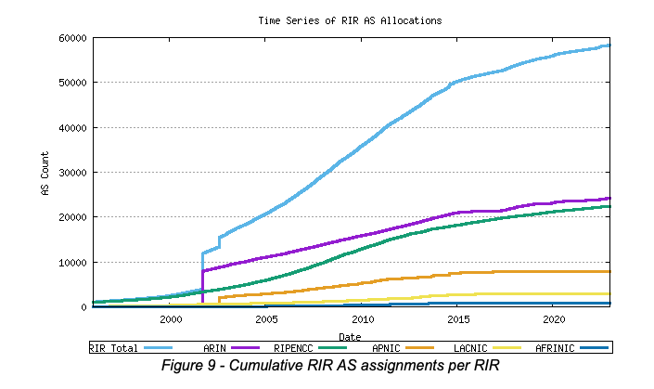
Internet size #AS
Source: http://bgp.potaroo.net

Slide 100
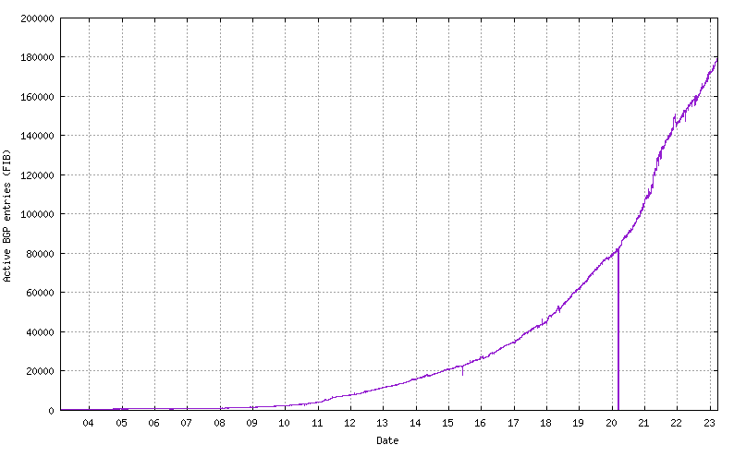
BGP IPv6 routing tables
Source: http://bgp.potaroo.net

Slide 101
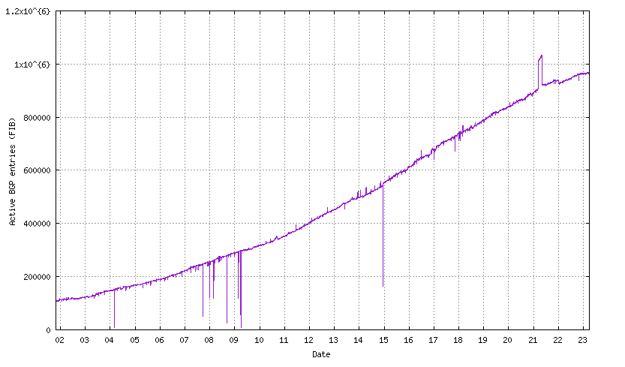
BGP : IPv4 routing tables
Source: http://bgp.potaroo.net

Slide 102
AS7007 incident

Slide 103
RIPE RIS
https://stat.ripe.net/AS2611#tabId=at-a-glance
https://stat.ripe.net/widget/looking-glass#w.resource=2001:6a8::/32
https://stat.ripe.net/2001:6A8::/32#tabId=routing

Slide 104
Youtube and Pakistan
http://www.ripe.net/internet-coordination/news/industry-developments/youtube-hijacking-a-ripe-ncc-ris-case-study

Slide 105
