Slide 1
Computer networking
Olivier Bonaventure
http://perso.uclouvain.be/olivier.bonaventure

Slide 2
Teaching material
Third edition https://www.computer-networking.info
Feedback/Fixes/Suggestions/Comments
http://github.com/cnp3/ebook

Slide 3
Networking blog
https://blog.computer-networking.info

Slide 5
Question
What are the topics that you expect to learn during this course ?

Slide 6
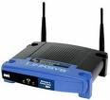
A simple Internet
RB
RA
RX
RY
RM
RN
R1
R2
R3

Slide 7
Course structure
Part 1 : Host behavior
Principles: serving applications, security, reliable transfer
Protocols: HTTP, SMTP, DNS, TLS, TCP, UDP,…
Part 2 : Building a network
Principles: packet forwarding, routing, congestion control
Protocols: IPv6, MPLS, RIP, OSPF, BGP, Ethernet, Wi-Fi
Practice
Learning by doing

Slide 8
Course organisation
First pass on the week topic (Thursday)
Students read book and prepare exercises
Inginious questions
Multiple choice questions
Some weeks : practical exercises as well
Discussion with teaching assistants (Thu/Fri)
Second pass on the week topics (Thursday)

Slide 9
Course evaluation
Projects (35%)
Analyze a networked app (20%)
Network configuration project (15%)
Written Exam
Both exercises and theory (65%)
Bonus

Slide 10
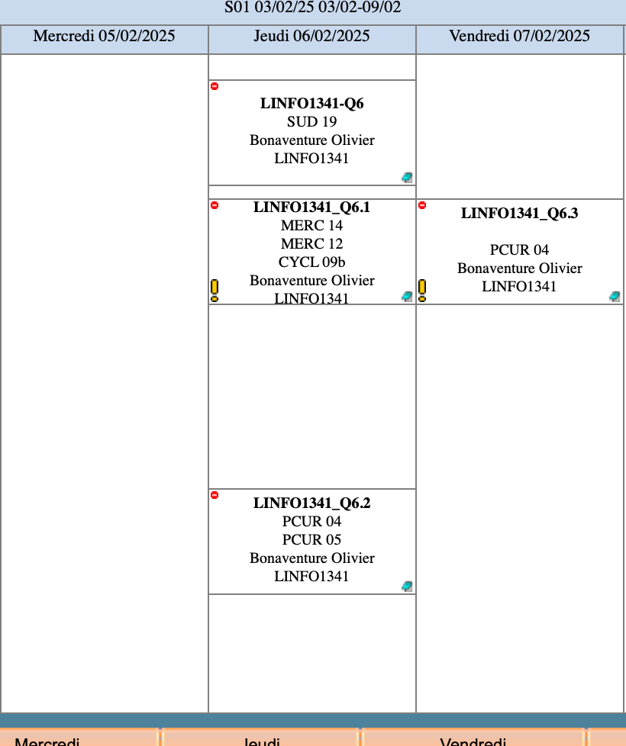
https://moodle.uclouvain.be/mod/choice/view.php?id=48329

Slide 11
Learning by doing ?

Slide 12
We also have tools

Slide 13
A simple Internet
Internet
RB
RA
RX
RY
RM
RN
R1
R2
R3

Slide 14
Question
During this course, we will describe all the components of the Internet, but when was this network created?

Slide 15
ARPANet
First ARPANet message, Oct. 29, 1969 https://en.wikipedia.org/wiki/ARPANET

Slide 16
Connecting two hosts

Slide 17
Question
What are the technologies that allow to connect two computers together ?

Slide 18
Question
What is the bandwidth (in bits/sec) that you can achieve on a telephone line over a several kilometers ?

Slide 19
VDSL and G.Fast
https://techzine.alcatel-lucent.com/fixed-access-stay-ahead-ultra-broadband-curve

Slide 20
Question
What is the bandwidth (in Mbps) that you can achieve using current wireless (4G/5G, Wi-Fi) networks ?

Slide 21
Question
What is the bandwidth (in Gbps/sec) that you can achieve on an optical fiber ?

Slide 22
Optical fiber
http://www.nature.com/nphoton/journal/v7/n5/fig_tab/nphoton.2013.94_F1.html

Slide 23
Question
What is the minimum delay (in msec) required to transmit one byte from Louvain-la-Neuve to Barcelone (+-1000 km) ?

Slide 24
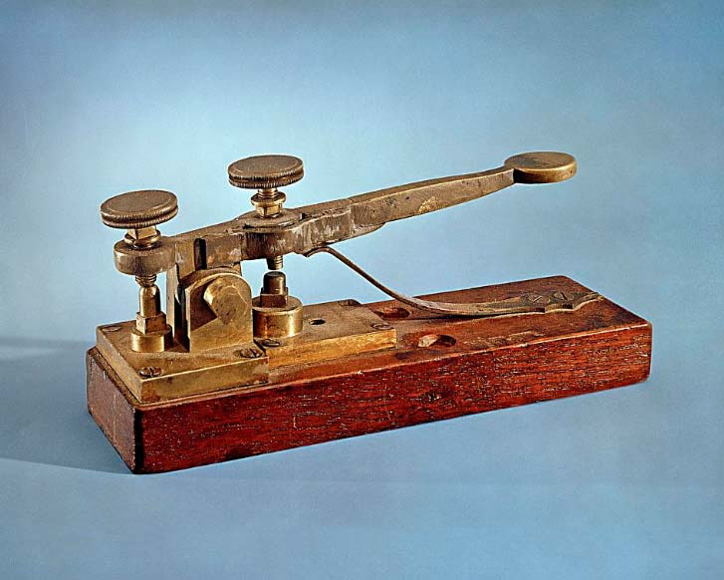
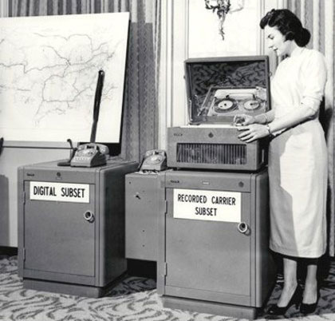
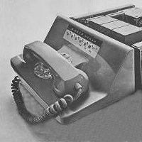
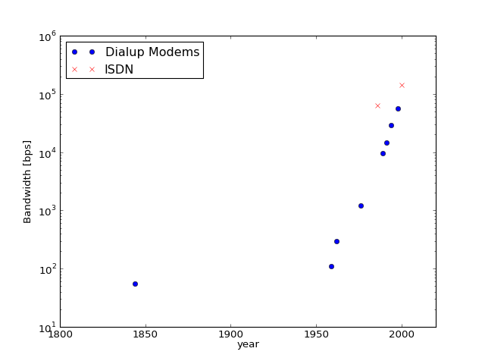
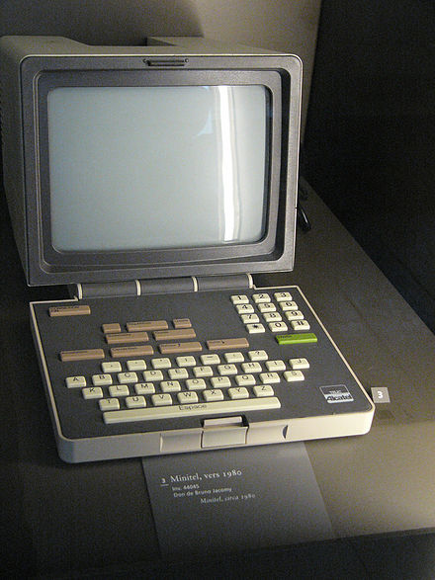
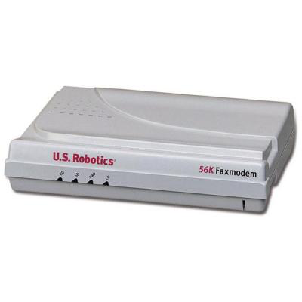
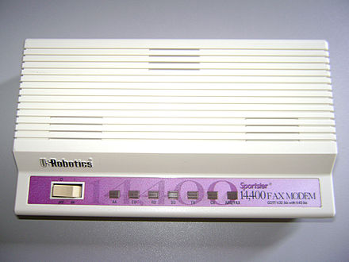
Modems and ISDN
Notes:
Morse telegraph - 1940
110 Bps AT&T 1950
300 BPs AT&T http://www.history-computer.com/ModernComputer/Basis/modem.html
1988 : Robotics 9600 bps https://en.wikipedia.org/wiki/File:Fax_modem_antigo.jpg
Minitel : années 1980

Slide 25
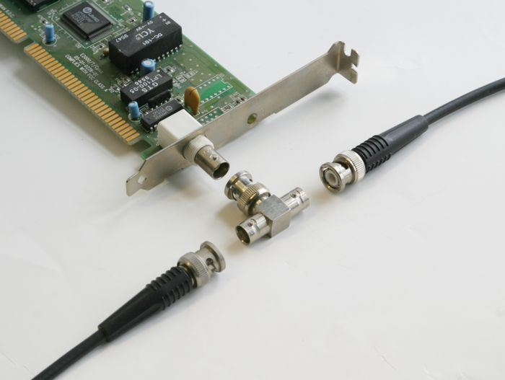
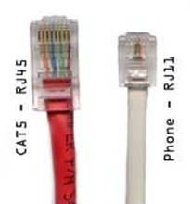
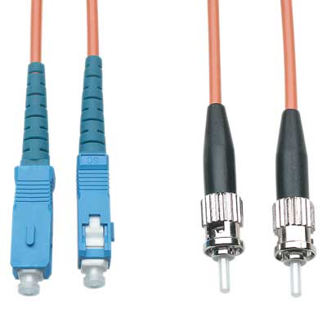
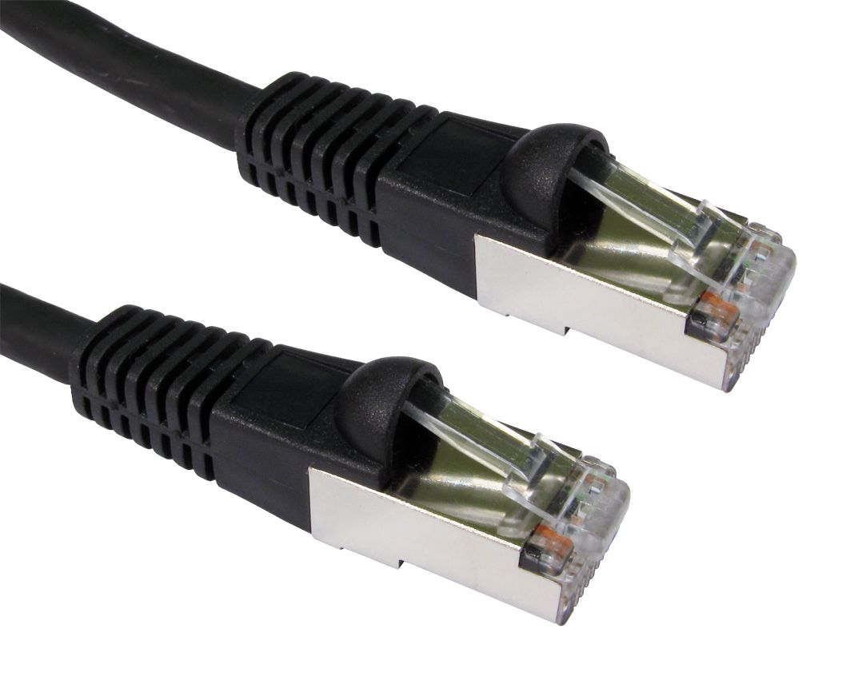
Local area networks

Slide 26
xDSL and DOCSIS

Slide 27
WiFi
802.11g
802.11n
802.11ac
802.11a
802.11b
802.11

Slide 28
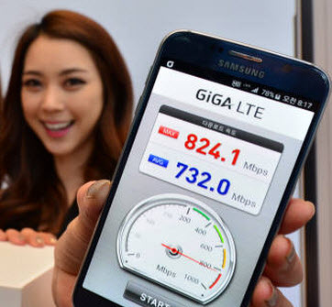
Cellular networks
2G
14.4 Kbps, GPRS: 56.6 Kbps, EDGE: 236 Kbps
3G
2, 3, 14 Mbps
4G
HSPA: 14, 42 Mbps, LTE : 173, 326 Mbps
https://en.wikipedia.org/wiki/List_of_device_bit_rates
http://www.netmanias.com/en/post/korea_ict_news/7591/korea-lte-mp-tcp-wi-fi/kt-s-giga-lte-world-s-first-commercial-wireless-1-giga-3-band-ca-giga-wifi

Slide 29
The physical layer
Transmitting bits over a wire
Time sequence diagram

Slide 30
Question
What are the types of errors that can affect the transmission of bits on a wire or radio link ?
Bit error, 0 replaced by 1 (and reverse)
Creation of bits (receiver receives more bits than those sent by sender)
Loss of bits (receiver receives fewer bits than those sent by sender)

Slide 31
The physical layer service
Bits
Physical layer
010100010100010101001010
Physical layer
Physical transmission medium
unreliable service
transmission errors

Slide 32
Time sequence diagram
How to represent the operation of the physical layer ?
A B
Data.request(0)
0
Data.request(1)
Data.ind(0)
1
Data.request(1)
Data.ind(1)
1
Data.ind(1)

Slide 33
Time sequence diagram
How to represent the unreliablity of the physical layer ?
A B
Data.request(0)
0
Data.request(1)
Data.ind(0)
0
Data.request(1)
Data.ind(0)
1
Data.ind(1)

Slide 34
Time sequence diagram
How to represent the fact that the physical layer can loose bits ?
A B
Data.request(0)
0
Data.request(1)
Data.ind(0)
Data.request(1)
1
Data.ind(1)

Slide 35
Time sequence diagram
How to represent the fact that the physical layer can create bits ?
A B
Data.request(0)
0
Data.request(1)
1
Data.ind(0)
Data.ind(1)
Data.request(0)
0
Data.ind(1)
Data.ind(0)

Slide 36
How do Internet hosts exchange data ?
Principles
Each host is identified by a unique IP address
Hosts echange data inside packets containing
IP address of the source
IP address of the destination
Data

Slide 37
Length of IP address
What is the length of an IP address in bits ?

Slide 38
Internet Protocol (IP) addresses
IPv4
32 bits, written as a.b.c.d, e.g. 130.104.1.1
IPv6
128 bits, written in hexadecimal notation,
2001:06a8:3080:0001:0000:0000:0000:0003
2001:6a8:3080:1::3

Slide 39
IPv6 addresses
IPv4
IP version 6
Each IPv6 address is encoded in 128 bits
3.4 x 10^38 possible addressable devices
6.65 x 10^23 addresses per square meter
Why 128 bits ?
Notes:
IP version 4 supports 4,294,967,296 distinct addresses, but some are reserved for :
private addresses (RFC1918)
loopback (127.0.0.1)
multicast
...

Slide 40
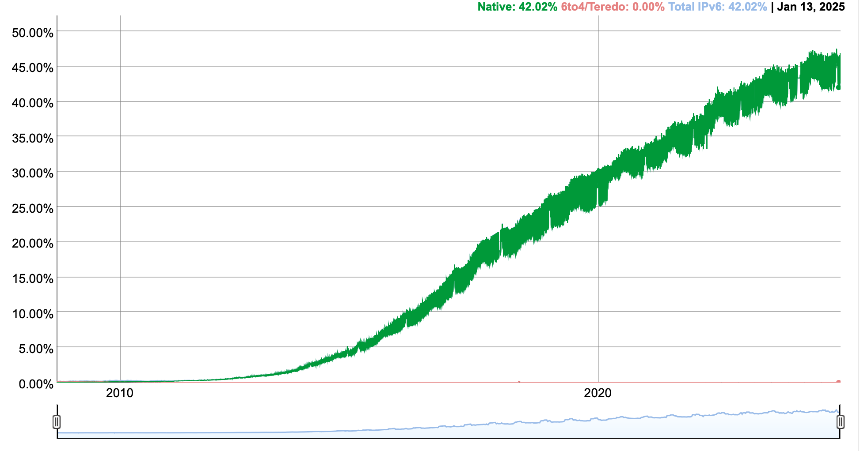
IPv6 adoption
What is percentage of IPv6 users in Belgium ?
Feb. 2025: 63.2%

Slide 41
Textual representation
Hexadecimal format
FEDC:BA98:7654:3210:FEDC:BA98:7654:3210
1080:0:0:0:8:800:200C:417A
Compact hexadecimal format
Some IPv6 addresses contain lots of zero
use "::" for one or more groups of 16 zeros.
1080:0:0:0:8:800:200C:417A = 1080::8:800:200C:417A
FF01:0:0:0:0:0:0:101 = FF01::101
0:0:0:0:0:0:0:1 = ::1

Slide 42
Types of interactions between two hosts
Datagram
Source sends a message to destination
Restriction on message length
Bytestream (aka Unix pipe)
All the bytes sent by the source in the bytestream will be later received by destination

Slide 43
Datagram exchange
A B
Data.request(Hello,)
Data.request(Bob)
Data.ind(Hello,)
Data.request(!)
Data.ind(Bob)
Data.ind(!)
Data.req(Nice to meet you)
Data.ind(Nice to meet you)

Slide 44
Limitations of datagrams
Message length
In theory 64 KBytes
In practice more than 1400 bytes is often risky
Datagram sequence is not always preserved
Datagrams can be lost
Datagrams can be duplicated

Slide 45
Lost datagrams
A B
Data.request(Hello,)
Data.request(Bob)
Data.ind(Hello,)
Data.request(!)
Data.ind(!)
Data.req(Nice to meet you)

Slide 46
Out-of-sequence Datagrams
A B
Data.request(Hello,)
Data.request(Bob)
Data.ind(Hello,)
Data.request(!)
Data.ind(!)
Data.ind(Bob)
Data.req(Nice to meet you)
Data.ind(Nice to meet you)

Slide 47
Duplicated Datagrams
A B
Data.request(Hello,)
Data.request(Bob)
Data.ind(Hello,)
Data.request(!)
Data.ind(Bob)
Data.ind(!)
Data.req(Nice to meet you)
Data.ind(Nice to meet you)
Data.ind(Bob)

Slide 48
Exchanging datagrams
What type of data can be exchanged ?
A datagram is sequence of bytes
How to exchange structured information ?
Integers
Floating point numbers
structures

Slide 49
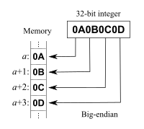
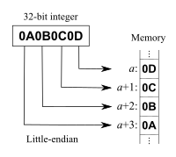
Little and big endian
How are integers stored in memory ?
For Internet protocols, integers are big-endian
Use htonl, ntohl and related functions
Source : https://en.wikipedia.org/wiki/Endianness

Slide 50
Representing datagrams containing binary data
8 bits
8 bits
16 bits
32 bits
Short integer
Flags
Char
32 bits
32 bits
Long integer
IPv4 address
IPv6 Address
128 bits
8 bits
Type
Length
Variable length field
8 bits
Padding
8 bits
length bytes

Slide 51
Reliable Bytestream
Three phases
Connection establishment
Communicating hosts agree to create two bytestreams, one per direction
Data transfer
Connection release

Slide 52
Connection establishment
Source
Network provider
Destination
CONNECT.request
CONNECT.indication
CONNECT.response
Destination considers connection open
CONNECT.confirm
Source considers
connection open

Slide 53
Connection refused
Source
Network provider
Destination
CONNECT.request
CONNECT.indication
DISCONNECT.request
DISCONNECT.indication

Slide 54
Connection impossible
Source
Network provider
Destination
CONNECT.request
DISCONNECT.indication

Slide 55
Data transfer Message mode
Source
Provider
Destination
CONNECT.request
CONNECT.indication
CONNECT.response
CONNECT.confirm
DATA.request("A")
DATA.ind("A")
DATA.request("BCD")
DATA.ind("BCD")
DATA.request("EF")
DATA.ind("EF")

Slide 56
Data transfer Stream mode
Source
Provider
Destination
CONNECT.request
CONNECT.indication
CONNECT.response
CONNECT.confirm
DATA.request("AB")
DATA.ind("A")
DATA.request("CD")
DATA.ind("B")
DATA.request("EF")
DATA.ind("C")
DATA.ind("DEF")

Slide 57
Abrupt release
Source
Provider
Destination
Connection opened
Connection opened
DATA.request("A")
DATA.request("B")
DISCONNECT.req(abrupt)
DATA.indication("A")
DATA.request("C")
DISCONNECT.indication
Can also be caused by the network
(e.g. network cannot anymore receive
packets from peer)

Slide 58
Abrupt release triggered by the network
Source
Provider
Destination
Connection opened
Connection opened
DATA.request("A")
DATA.request("B")
DISCONNECT.indication
DATA.indication("A")
DATA.request("C")
DISCONNECT.indication

Slide 59
Graceful release
Source
Provider
Destination
Connection opened
Connection opened
DATA.request("A")
DATA.request("B")
DATA.request("C")
DISCONNECT.req(graceful)
DATA.indication("A")
Source->Destination connection closed
DATA.indication("B")
DISCONNECT.ind(graceful)
DATA.indication("C")
DATA.request("D")
DATA.indication("D")
DISCONNECT.req(graceful)
DISCONNECT.ind(graceful)
Connection closed
Connection closed

Slide 60
Internet Transport services
Service provided by UDP
Connectionless, unreliable
Service provided by TCP
Connection-oriented
reliable bytestream

Slide 61
Multiplexing
How to multiplex data coming from multiple applications on a single host having a single IP address ?

Slide 62
Multiplexing
Request
Source Addr: Client
Dest. Addr: Server
Client
Source port : 1234
Destination port: 5678
Server
Source Addr: Server
Dest. Addr: Client
Source port : 5678
Destination port: 1234
Response

Slide 63
UDP protocol
IP Packet
Used to identify the application that will receive this segment on destination host
Used to identify the application that sent this segment on sending host
32 bits
Source Port
Destination port
8 bytes
UDP length
UDP Checksum
Checksum computed over the entire UDP segment and part of the IP header to detect transmission errors.
0 means that the sender did not compute a checksum.
Constraint
Each UDP segment must fit inside a single IP packet
Payload
Notes:
The computation of the UDP checksum is defined in :
R. Braden, D. Borman, C. Partridge, Computing the Internet Checksum, RFC1071, Septembre 1988

Slide 64
UDP ports
Request
Client
Server
Source port : 1234
Destination port: 5678
Source port : 5678
Destination port: 1234
Response

Slide 65
UDP Applications
Among these applications, which typically use UDP ?
Voice over IP
ssh
web
Microsoft Teams
Netflix

Slide 66
Usage of UDP
Request-response applications
DNS, RPC, NFS, ..
Applications with short delay
Games
Multimedia transfer
Voice over IP
Video over IP

Slide 67
Multiplexing
Request
Client
Source port : 1234
Destination port: 5678
Server
Source port : 5678
Destination port: 1234
Response

Slide 68
Connection table
A server interacts with many different clients and maintains a connection table
This table contains one entry per active connection with its state
Each connection is identified by 4 infos
Client address and port
Server address and port

Slide 69
Datagram - UDP
Applic. 1
Applic. 2
UDP service
Identification:
IP address : 2001:6a8:3080:2:217:f2ff:fed6:65c0
Protocol : UDP
Port : 1234
Identification
IP address : 2001:4860:a005::68
Protocol : UDP
Port : 53
Identification of an application
IP address + port number
Notes:
UDP is defined in
J. Postel, User Datagram Protocol. RFC768, August 1980
It will be described in more details later

Slide 70
Bytestream - TCP
Applic. 1
Applic. 2
TCP service
Identification:
IP address : 2a02:2788:2c4:16f:226:bbff:fe09:266e
Protocol : TCP
Port : 9876
Identification
IP address: 2001:6a8:3080:1::3
Protocol : TCP
Port : 80
Identification of an application
IP address + TCP + port number
Notes:
TCP is defined in
J. Postel, Transmission Control Protocol, RFC793, September 1981
It will be described in more details later

Slide 71
Agenda
Internet applications
DNS
Email
Web

Slide 72
Naming and addressing
address
A (usually) fixed-length bit string that uniquely identifies a device (or an interface) in a network
name
A human understandable name that identifies a device in a network

Slide 73
Names and addresses
Different types of relations between names and addresses
One-to-one
A unique name corresponds to each unique address
One-to-many
A name corresponds to several addresses
Many-to-one
Several names correspond to the same address

Slide 74
Names
How can we assign unique and non-ambiguous names to devices ?

Slide 75
The tree of names
At each level, a secretariat verifies that domain names are unique
A bit more than 1200 TLDs

Slide 76
Domain names
Each domain name is a series of strings separated by dots
First version of DNS. Modern DNS supports unicode

Slide 77
Mapping names to addresses
How to map names to addresses ?
First approach
Distribute a file containing the mapping to all hosts
See /etc/hosts on Unix
https://en.wikipedia.org/wiki/Hosts_%28file%29

Slide 78
The Domain Name System A distributed database
Each domain is managed by a name server which can:
map a local name to an address
return the name of a name server that is responsible for a domain

Slide 79
How to query a name server ?
Which service would you use to query a name server ?
Reliable connection oriented (TCP)
Unreliable connectionless (UDP)

Slide 80
DNS Resource Records
Each RR is structured as
Type
Length
Value
TTL
A
IPv4 address
AAAA
IPv6 address
NS
Name server
Other specific records : CNAME, MX, TXT, ...
Notes:
The RR MX were proposed in
C. Partridge. Mail routing and the domain system. Request for Comments 974, Internet Engineering Task Force, January 1986.
A complete list of DNS RR may be found at
http://www.its.uq.edu.au/tn-0011

Slide 81
The root DNS servers
Thirteen servers that know the name servers that are responsible for the Top-Level-Domain names

Slide 82
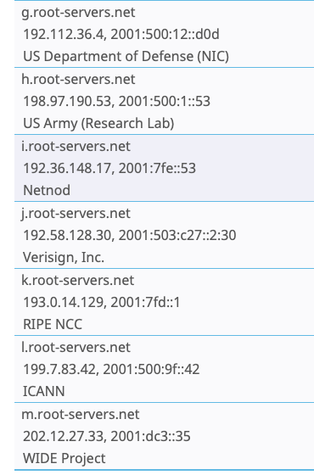
The Root Servers

Slide 83
Example
Resolve www.google.com
Try to resolve www.computer-networking.info starting from the root from home

Slide 84
DNS resolution (1)
www.google.com
Root
2001:dc3::35
Google.com NS
2001:4860:4802:32::a
Com NS
2001:501:b1f9::30
NS ? com
NS -> m.gtld-servers.net. Additional m.gtld-servers.net = 2001:501:b1f9::30
NS ? Google.com
NS -> ns1.google.com.
Additional: ns1.google.com = 2001:4860:4802:32::a
AAAA ? www.google.com
AAAA -> 2a00:1450:4009:80a::2004

Slide 85
DNS resolution (1)
www.computer-networking.info
Root
2001:dc3::35
Info NS
2001:500:19::1
NS ? info
NS -> a0.info.afilias-nst.info. Additional a0..info = 2001:500:19::1
NS ? Computer-networking.info
NS -> ns20.ovh.net
NS ? net
NS -> m.gtld-servers.net. Additional m..net = 2001:501:b1f9::30

Slide 86
DNS resolution (2)
www.computer-networking.info
Net NS
2001:501:b1f9::30
OVH NS
2001:41d0:1:1981::1
Ns20.ovh.net
2001:41d0:1:198f::1
NS ? ovh.net
NS ? Ns10.ovh.net. Additional ns10.ovh.net = 2001:41d0:1:1981::1
AAAA ? Ns20.ovh.net
AAAA -> 2001:41d0:1:198f::1
AAAA ? www.computer-networking.info
CNAME cnp3book.info.ucl.ac.be

Slide 87
DNS resolution (3)
www.computer-networking.info
Root
2001:dc3::35
Ac.Be NS
2001:6a8:3c80::14
Be NS
2001:678:6c::1
NS ? be
NS -> d.nsset.be.
Additional d.nsset.be = 2001:678:6c::1
NS ? Ac.be
NS -> ns1.belnet.be.
Additional : 2001:6a8:3c80::14
NS ? Ucl.ac.be
NS -> ns1.belnet.be
NS -> ns1.sri.ucl.ac.be

Slide 88
DNS resolution (4)
www.computer-networking.info
Ucl.ac.Be NS
2001:6a8:3c80::14
Info.ucl.ac.Be NS
2001:6a8:308f:1::d
NS ? Info.ucl.ac.be
NS -> dnssrv.info.ucl.ac.be.
Additional dnss..be = 2001:6a8:308f:1::d
AAAA ? Cnp3book.info.ucl.ac.be
cnp3book.info.ucl.ac.be. CNAME mptcp.info.ucl.ac.be.
mptcp.info.ucl.ac.be. AAAA 2001:6a8:308f:8:0:82ff:fe68:e48c

Slide 89
Root servers
Which questions are valid for root servers ?
;; QUESTION SECTION:
;be. IN NS
;; AUTHORITY SECTION:
be. 172800 IN NS c.nsset.be.
be. 172800 IN NS d.nsset.be.
;; ADDITIONAL SECTION:
d.nsset.be. 172800 IN A 194.0.44.1
c.nsset.be. 172800 IN A 194.0.43.1
d.nsset.be. 172800 IN AAAA 2001:678:6c::1
c.nsset.be. 172800 IN AAAA 2001:678:68::1
dig -t NS net @2001:dc3::35
dig -t AAAA www.uclouvain.be @2001:dc3::35
dig -t NS be @2001:dc3::35 dig -t A dns.be @2001:dc3::35

Slide 90
DNS messages
What is the role of the identification field ?
32 bits
Question/Response
Recursive question or not
Authoritative answer or not
Possible error
Identification
Flags
12 bytes
Number of questions
Number of answers
Number of authority
Number of additional
Questions
(variable number of resource records)
Answers
(variable number of resource records)
Authority
(variable number of resource records)
Additional information
(variable number of resource records)

Slide 91
DNS messages
Each DNS request contains a number that will be returned in the
response by the server to allow the client to match the request.
32 bits
Question/Response
Recursive question or not
Authoritative answer or not
Possible error
Identification
Flags
12 bytes
Number of questions
Number of answers
Number of authority
Number of additional
Questions
(variable number of resource records)
Answers
(variable number of resource records)
Authority
(variable number of resource records)
Additional information
(variable number of resource records)

Slide 92
DNS Resource Records
Each DNS messages is composed of resource records (RR) encoded as TLV
< Name, Value, Type, TTL>
Types of RR
A (Address)
Name is a hostname and Value an IPv4 address
AAAA (Address)
Name is a hostname and Value an IPv6 address
NS (NameServer)
Name is a domain name and Value is the hostname of the DNS server responsible for this domain
MX (Mail Exchange)
Name is a domain name and Value is the name of the SMTP server that must be contacted to send emails to this domain
Type CNAME
Alias

Slide 93
Using wireshark with DNS

Slide 94
Example
dig -t AAAA www.ietf.org @2001:6a8:3081:1::53
; <<>> DiG 9.10.2-P1 <<>> -t AAAA www.ietf.org @2001:6a8:3081:1::53
;; ->>HEADER<<- opcode: QUERY, status: NOERROR, id: 33225
;; flags: qr rd ra ad; QUERY: 1, ANSWER: 3, AUTHORITY: 0, ADDITIONAL: 1
;; OPT PSEUDOSECTION:
; EDNS: version: 0, flags:; udp: 4096
;; QUESTION SECTION:
;www.ietf.org. IN AAAA
;; ANSWER SECTION:
www.ietf.org. 1215 IN CNAME www.ietf.org.cdn.cloudflare-dnssec.net.
www.ietf.org.cdn.cloudflare-dnssec.net. 71 IN AAAA 2400:cb00:2048:1::6814:55
www.ietf.org.cdn.cloudflare-dnssec.net. 71 IN AAAA 2400:cb00:2048:1::6814:155
;; Query time: 1 msec
;; SERVER: 2001:6a8:3081:1::53#53(2001:6a8:3081:1::53)
;; WHEN: Thu Oct 15 12:05:47 CEST 2015
;; MSG SIZE rcvd: 149

Slide 95
Packets exchanged
sudo tcpdump -n -i en4 -vv udp port 53
tcpdump: listening on en4, link-type EN10MB (Ethernet), capture size 262144 bytes
09:16:50.749400 IP6 (flowlabel 0x8ea5d, hlim 64, next-header UDP (17)
payload length: 38)
2001:6a8:3080:2:2908:3cb4:bbb4:ae0e.56551 > 2001:4860:4860::8888.53:
36945+ A? www.ietf.org. (30)
09:16:50.769351 IP6 (hlim 55, next-header UDP (17) payload length: 115)
2001:4860:4860::8888.53 >
2001:6a8:3080:2:2908:3cb4:bbb4:ae0e.56551:
36945 q: A? www.ietf.org. 3/0/0 www.ietf.org. CNAME www.ietf.org.cdn.cloudflare.net., www.ietf.org.cdn.cloudflare.net. A
104.20.1.85, www.ietf.org.cdn.cloudflare.net. A 104.20.0.85 (107)

Slide 96
DNS in practice
Most users do not interact directly with root DNS resolvers
Enterprise, ISPs deploy DNS resolvers
Servers that perform recursive DNS queries
dig -t A www.google.com +short @@ns1.sri.ucl.ac.be
142.250.184.228

Slide 97
DNS Resolvers
Local resolvers inside UCLouvain
130.104.230.68
130.104.1.1
130.104.1.2
2001:6a8:3081:1::53
Open DNS resolvers
8.8.8.8, 1.1.1.1, 9.9.9.9
2001:4860:4860::8888, ...

Slide 98
Example
dig www.ietf.org @2001:4860:4860::8888
; <<>> DiG 9.8.3-P1 <<>> www.ietf.org @2001:4860:4860::8888
;; ->>HEADER<<- opcode: QUERY, status: NOERROR, id: 36945
;; flags: qr rd ra; QUERY: 1, ANSWER: 3, AUTHORITY: 0, ADDITIONAL: 0
;; QUESTION SECTION:
;www.ietf.org. IN A
;; ANSWER SECTION:
www.ietf.org. 1441 IN CNAME www.ietf.org.cdn.cloudflare.net.
www.ietf.org.cdn.cloudflare.net. 43 IN A 104.20.1.85
www.ietf.org.cdn.cloudflare.net. 43 IN A 104.20.0.85
;; Query time: 39 msec
;; SERVER: 2001:4860:4860::8888#53(2001:4860:4860::8888)
;; WHEN: Tue Oct 21 09:16:50 2014
;; MSG SIZE rcvd: 107
What is a CNAME record ?

Slide 99
DNS spoofing attack
What is this attack ?
How to counter it ?
dig porttest.dns-oarc.net TXT @2001:6a8:3081:1::53 +short
porttest.y.x.w.v.u.t.s.r.q.p.o.n.m.l.k.j.i.h.g.f.e.d.c.b.a.pt.dns-oarc.net.
"130.104.1.1 is GREAT: 26 queries in 3.8 seconds from 26 ports with std dev 15934"

Slide 100
Agenda
Protocol stack
Internet applications
DNS
Email
Web

Slide 101
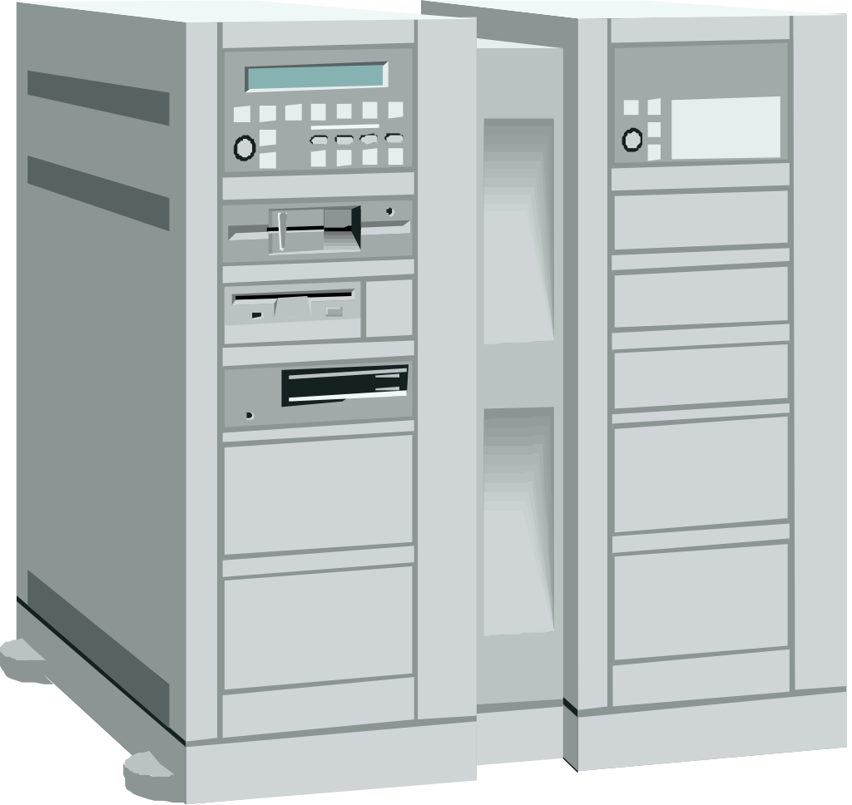
Simplified architecture
Alice’s email server
b.net ‘s email server
Alice@a.net
Bob@b.net
Alice sends her email to local mail forwarder
Bob retrieves message from his server
Alice’s server sends email to b.net’s MX

Slide 102
Message format
From: president@abc.be
To: ceo@def.com
Subject: Hello
Date : 27 Sept. 1999 0901
Header
Exp: ABC S.A.
Rue de Fer 10
5000 Namur
Dear Sir,
Bla Bla Bla...
Message body
DEF Corp.
Steel street 9
WA78 AX London
Grande Bretagne

Slide 103
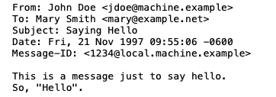
Email message format
An email message is a series of ASCII lines
The first lines are the header lines that indicate control information

Slide 104
Header format
At least three lines that end with <CRLF>
From: sender@domain
To:recipient@domain
Date: <creation date of message>
Optional fields
Subject: , cc: ,Message-ID:, Received: In-Reply-To: , ...
Header ends with empty line (<CRLF>)

Slide 105
Sample messages

Slide 106
MIME
Multipurpose Internet Mail Extensions
Constraints
must remain compatible with old email servers
short US-ASCII Lines
must support non-English text
must support various formats
must allow to transmit audio, video, ..
Notes:
MIME was defined in
N. Freed and N. Borenstein. Multipurpose internet mail extensions (MIME) part one: Format of internet message bodies. Request for Comments 2045, Internet Engineering Task Force, November 1996.
N. Freed and N. Borenstein. Multipurpose internet mail extensions (MIME) part two: Media types. Request for Comments 2046, Internet Engineering Task Force, November 1996.

Slide 107
MIME (2)
New header fields
MIME-Version:
version of MIME used to encode message
Content-Description:
comment describing the content of the message
Content-Type:
type of information inside message
Content-Transfer-Encoding:
how the message has been encoded
Content-Id:
unique identifier for the content

Slide 108
MIME: Content-Type
Content-Type : type/encoding
type of content
text, image, video, application
multipart
encoding of content
text/plain , text/html, image/gif, image/jpeg , audio/basic, video/mpeg, video/quicktime, application/octet-stream, application/postscript
multipart/alternative, multipart/mixed
attachment

Slide 109
Character sets
How to support rich character sets ?
Content-Type: text/plain; charset=us-ascii
Content-Type: text/plain; charset=iso-8859-1
Character set suitable for Western European languages, defined by ISO, 8 bits per character
Content-Type: text/plain; charset=unicode
Universal character set

Slide 110
Content encoding
How to encode non-text data ?
Base64
Base64
uses ASCII characters A...Z,a...z,0...9, "+" et "/"
A=0, B=1, C=2, ... +=62 et /=63
Each character is used to encode 6 bits
24 bits from initial message -> 4 ASCII characters
Special character “=” used for padding

Slide 111
Multipart/mixed
Date: Mon, 20 Sep 1999 16:33:16 +0200
From: Nathaniel Borenstein <nsb@bellcore.com>
To: Ned Freed <ned@innosoft.com>
Subject: Test
MIME-Version: 1.0
Content-Type: multipart/mixed; boundary="simple boundary"
preamble, to be ignored
--simple boundary
Content-Type: text/plain; charset=us-ascii
partie 1
--simple boundary
Content-Type: text/plain; charset=us-ascii
partie 2
--simple boundary
Notes:
Exemple de message MIME
Received: from loriot.info.fundp.ac.be (loriot.info.fundp.ac.be [138.48.32.96])
by leibniz.info.fundp.ac.be (8.9.1/8.9.1) with SMTP id QAA19679;
Mon, 20 Sep 1999 16:37:25 +0200 (MET DST)
Message-Id: <3.0.5.32.19990920163316.00866340@info.fundp.ac.be>
Date: Mon, 20 Sep 1999 16:33:16 +0200
To: pers-aca, pers-sci
From: Gysele HENRARD <ghe@info.fundp.ac.be>
Subject: listes
Mime-Version: 1.0
Content-Type: multipart/mixed;
boundary="=====================_937830796==_"
--=====================_937830796==_
Content-Type: text/plain; charset="iso-8859-1"
Content-Transfer-Encoding: quoted-printable
Bonjour,
Voici des listes de 1M-1L, 2M-2L et ERASMUS mises =E0 jour ce lundi 20
septembre.
Gyselle
--=====================_937830796==_
Content-Type: application/octet-stream; name="1M_99_00.xls";
x-mac-type="584C5334"; x-mac-creator="5843454C"
...

Slide 112
Email protocols
SMTP
Email retrieval
SMTP
a.net’s SMTP server
b.net’s SMTP server
Alice@a.net
Bob@b.net
Email retrieval:
POP
IMAP
Web interface
File access (/var/mail on Unix)

Slide 113
SMTP : sending email
S: 220 smtp.example.com ESMTP Postfix
C: HELO relay.example.org
S: 250 Hello relay.example.org, I am glad to meet you
C: MAIL FROM:<bob@example.org>
S: 250 Ok
C: RCPT TO:<alice@example.com>
S: 250 Ok
C: RCPT TO:<theboss@example.com>
S: 250 Ok
C: DATA
S: 354 End data with <CR><LF>.<CR><LF>
C: From: "Bob Example" <bob@example.org>
C: To: "Alice Example" <alice@example.com>
C: Cc: theboss@example.com
C: Date: Tue, 15 Jan 2008 16:02:43 -0500
C: Subject: Test message C: C: Hello Alice.
C: This is a test message with 5 header fields and 4 lines in the message body.
C: Your friend,
C: Bob
C: .
S: 250 Ok: queued as 12345
C: QUIT
S: 221 Bye
Client opens TCP connection with server port 25

Slide 114
POP : retrieving email
Client opens TCP connection with server port 110
S: +OK POP3 server ready <1896.697170952@dbc.mtview.ca.us>
C: APOP mrose c4c9334bac560ecc979e58001b3e22fb
S: +OK mrose's maildrop has 2 messages (320 octets)
C: STAT
S: +OK 2 320
C: LIST
S: +OK 2 messages (320 octets)
S: 1 120
S: 2 200
S: .
C: RETR 1
S: +OK 120 octets
S: <the POP3 server sends message 1>
S: .
C: DELE 1
S: +OK message 1 deleted
C: DELE 2
S: +OK message 2 deleted
C: QUIT
S: +OK dewey POP3 server signing off (maildrop empty)

Slide 115
Agenda
Protocol stack
Internet applications
DNS
Email
Web

Slide 116
Question
When (year) were the first public web servers launched ?

Slide 117
https://home.cern/science/computing/birth-web/short-history-web

Slide 118
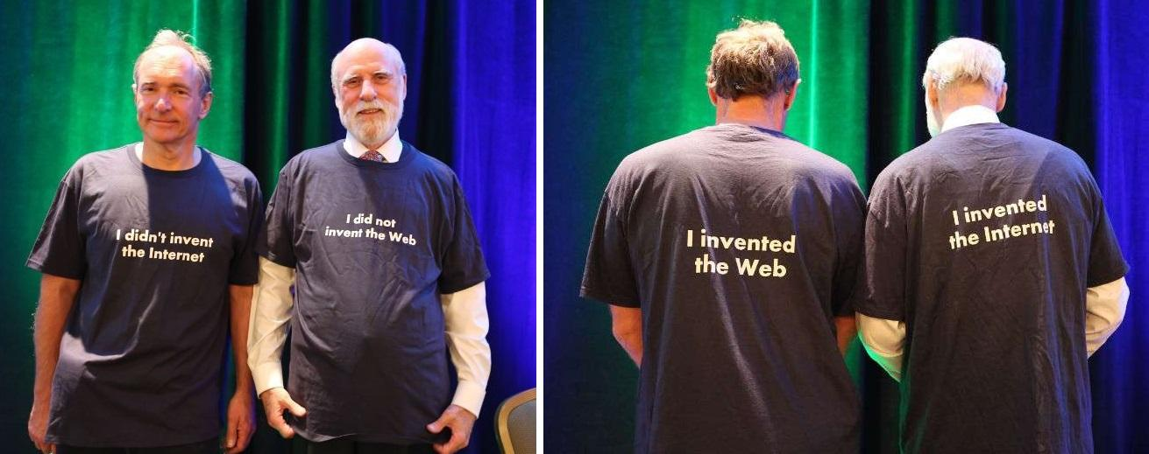
Internet versus web
https://www.reddit.com/r/pcmasterrace/comments/b086lz/tim_bernerslee_and_vint_cerf_wearing_funny_shirts/

Slide 119
Simplified architecture
Server www.machin.be
Server www.truc.fr
Query
Information
Client
(browser)

Slide 120
Key elements of the web
URL : An addressing scheme that allows to identify any document stored on a server
HTML : hypertext language to easily write documents with hypertext links
HTTP : An efficient and lightweight protocol to exchange documents
Servers
Clients (browsers)

Slide 121
URL
syntax : <protocol>://<document>
http is the most common
https implies added security (see later)
document indicates the server and the location of the document
<user>:<password>@<server>:<port>/<path>

Slide 122
HTML
<HTML>
<HEAD>
<TITLE>HTML test page</TITLE>
</HEAD>
<BODY>
<IMG SRC="http://www.images.be/logo.gif">
<H1>Web servers from UCL UCL<P></H1>
<HR>
<UL>
<LI><A HREF="http://www.uclouvain.be">UCL</A>
<LI><A HREF="http://www.info.ucl.ac.be">CSE Dept.</A>
<LI><A HREF="http://www.math.ucl.ac.be">Math</A>
</UL>
</BODY>
</HTML>
Header
Image on remote server
First level title
Body
External hypertext link

Slide 123
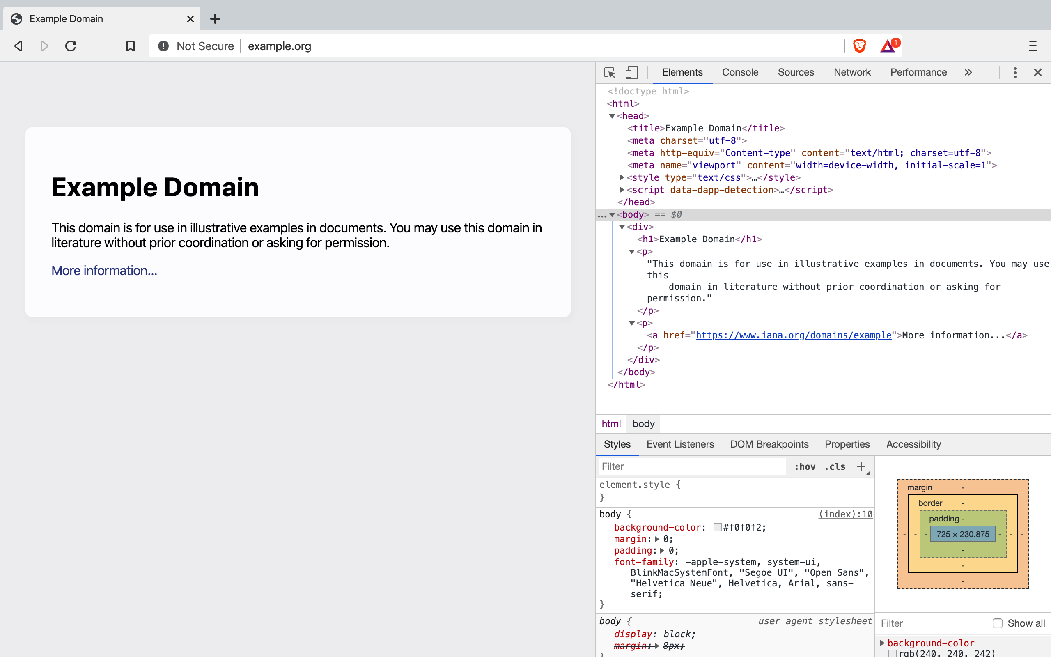

Slide 124
HTTP
Method
GET
POST
...
Header contains additional information about request sent by client
Request
Method
Header
CRLF
MIME Document
Client
Server
Response
Status line
Header
CRLF
MIME Document
Success or failure
Header contains information about server
and optional parameters specific to response
HTTP is a stateless protocol, server does not maintain any state from one request to another

Slide 125
HTTP
Which transport service would you select to support HTTP ?
Unreliable connectionless service (UDP)
Reliable bytestream connection-oriented (TCP)

Slide 126
HTTP/1.0
HTTP 1.0 - non-persistent connection
Client
Server
CONNECT.request
CONNECT.indication
CONNECT.response
CONNECT.confirm
DATA.request(Request)
DATA.ind(Request)
DATA.req(Response)
DATA.ind(Response)
DISCONNECT.req
DISCONNECT.ind
DISCONNECT.ind
DISCONNECT.req
Notes:
HTTP 1.0 is defined in :
T. Berners-Lee, R. Fielding, and H. Frystyk. Hypertext transfer protocol -- HTTP/1.0. Request for Comments 1945, Internet Engineering Task Force, May 1996.

Slide 127
HTTP : Methods
Methods
GET
method used to request a "document" stored on server
GET <document> HTTP/1.0
POST
method used to send a "document" to a server
document is part of the request and encoded as a MIME document

Slide 128
Request headers
Host: <name>
Name of the server where the document is stored
Authorization
allows to perform access control
If-Modified-Since: <date>
server will only send if more recent than date
Referer: <url>
URL visited by the client before this request
User-Agent: <agent>
client’s browser

Slide 129
HTTP : Status line
Format : Version_HTTP Code Comment
Success/Failure
2xx : Success
Example : HTTP/1.0 200 OK
3xx : Redirection
4xx : Client-side error
5xx : Server-side error

Slide 130
HTTP Response
Date
date of the document attached to response
Server
Name and version of http server used
Content-*
MIME header of the attached document

Slide 131
HTTP : Example
curl -v http://www.example.org
Request
Server
www.example.org
GET / HTTP/1.1
Host: www.example.org
User-Agent: curl/7.64.1
Accept: */*
CRLF
Client
Response
HTTP/1.1 200 OK
Cache-Control: max-age=604800
Content-Type: text/html; charset=UTF-8
Date: Wed, 08 Feb 2023 19:08:16 GMT
Expires: Wed, 15 Feb 2023 19:08:16 GMT
Last-Modified: Thu, 17 Oct 2019 07:18:26 GMT
Server: ECS (nyb/1D2B)
Content-Length: 1256
CRLF
<HTML>
. . .
</HTML>

Slide 132
HTTP 1.1
HTTP 1.0
a single TCP connection is used to transmit a single document (html file, image,...)
HTTP 1.1
uses a single persistent TCP connection
This TCP connection can be used for several requests and the corresponding responses
the cost of establishing and releasing the TCP connection is amortised over multiple requests
Although HTTP 1.1 uses a single TCP connection for multiple requests, HTTP 1.1 remains stateless
Notes:
HTTP 1.1 is defined in :
R. Fielding, J. Gettys, J. Mogul, H. Frystyk, L. Masinter, P. Leach, and T. Berners-Lee. Hypertext transfer protocol -- HTTP/1.1. Request for Comments 2616, Internet Engineering Task Force, June 1999.

Slide 133
HTTP 1.1
Server
Client
CONNECT.request
CONNECT.indication
CONNECT.confirm
CONNECT.response
GET / HTTP1.1
Connection: Keep-Alive
...
HTTP/1.1 200 OK
Keep-Alive: timeout=15, max=100
Connection: Keep-Alive
...
GET /images/logo.gif HTTP1.1
Connection: Keep-Alive
...
HTTP/1.1 200 OK
Keep-Alive: timeout=15, max=99
Connection: Keep-Alive
...
DISCONNECT.req
DISCONNECT.ind
DISCONNECT.ind
DISCONNECT.req

Slide 134
HTTP Authentication
Client
Server
GET / HTTP1.1
...
HTTP/1.0 401 Authorization req
WWW authenticate: machin
...
Browser asks user/password to user
GET / HTTP1.1
Authorization: User-password
...
HTTP/1.1 200 OK
...
GET /images/t.gif HTTP1.1
Authorization: User-password
...
Browser sends user/password in each request

Slide 135
HTTP Cookies
Client
Server
GET / HTTP1.1
...
HTTP/1.0 200 OK
Set-Cookie: machin
...
Browser saves cookie
Normal response
GET /doc HTTP1.1
Cookie: machin
...
HTTP/1.1 200 OK
...
Response is function of URL and cookie
GET /images/t.gif HTTP1.1
Cookie: machin
...
Browser sends cookie in all requests sent to server

Slide 136
The Host header One server many sites
$dig +short www.olln.be
site-ottignieslouvainlaneuve.imio.be.
lb.imio.be.
188.165.186.183, 188.165.186.179
$ dig +short www.gembloux.be
site-gembloux.imio.be.
lb.imio.be.
188.165.186.179, 188.165.186.183
Server:
www.gembloux.be
www.olln.be

Slide 137
A single physical server for many TLS services
Server Name Indication
Tom
Alice
Bob
Pub_{C, ,}Pub_{Tom,},Priv_{Tom}
S(Pub_{Tom} , Priv_{C} )‏
Pub_{C,}
Pub_{C, ,}Pub_{Bob,},Priv_{Bob}
S(Pub_{Bob} , Priv_{C} )‏
ClientHello (SNI=bob.be Ciphers, Random_{Alice})‏
ServerHello(Ciphers,Random_{Bob} )‏
Certificate(Pub_{Bob} , Priv_{C} )‏
Alice chooses PreMaster Secret
E( PreMasterSecret , Pub_{Bob})‏
Finished( H(handshake msgs,Key)‏
Finished( H(handshake msgs,Key))‏

Slide 138
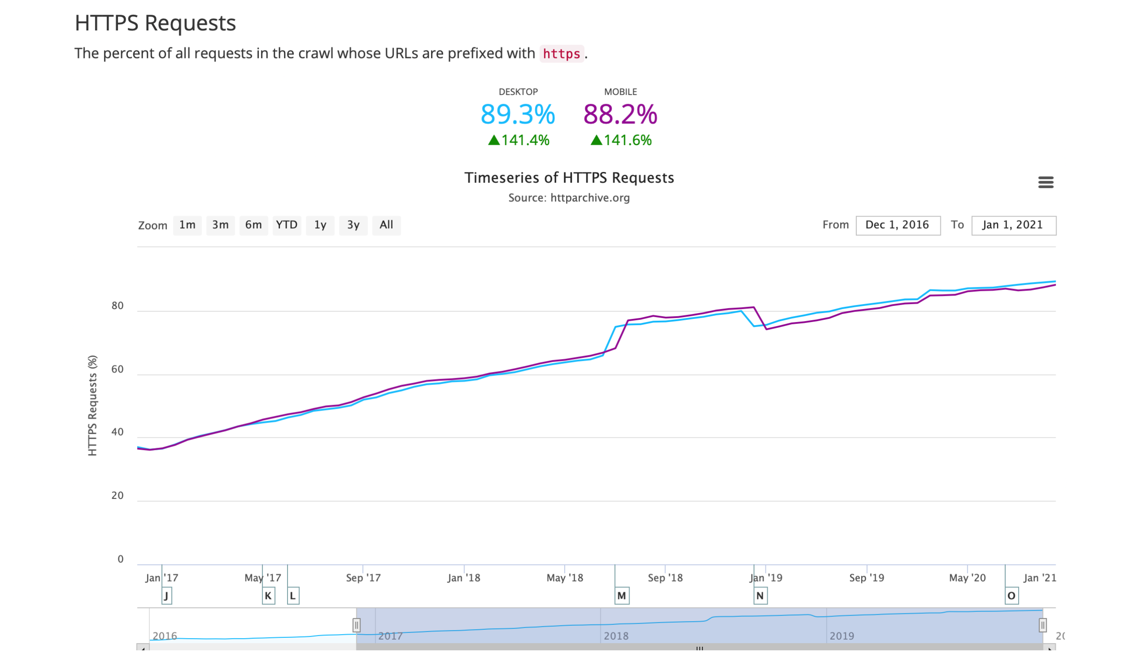
HTTPS versus HTTP

Slide 139
Question
What is the average size of a web page (in bytes) ?

Slide 140
https://httparchive.org/reports/state-of-the-web#bytesTotal

Slide 141
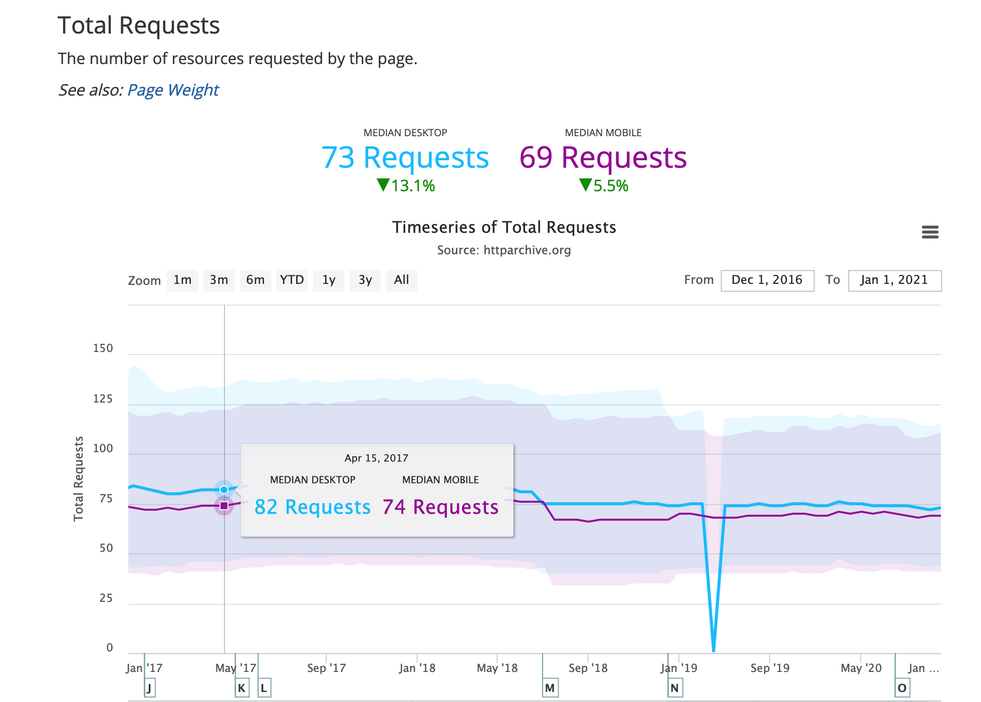
How many HTTP requests per page ?
Source: httparchive.org

Slide 142
Today's web pages
Can you order the different elements of web pages in terms of importance ( smallest average volume first) ?
CSS
Font
HTML
Images
Javascript
Video
HTML
CSS
Font
Javascript
Images
Video
Source: https://httparchive.org/reports/page-weight.org

Slide 143
https://amelie.info.ucl.ac.be

Slide 144
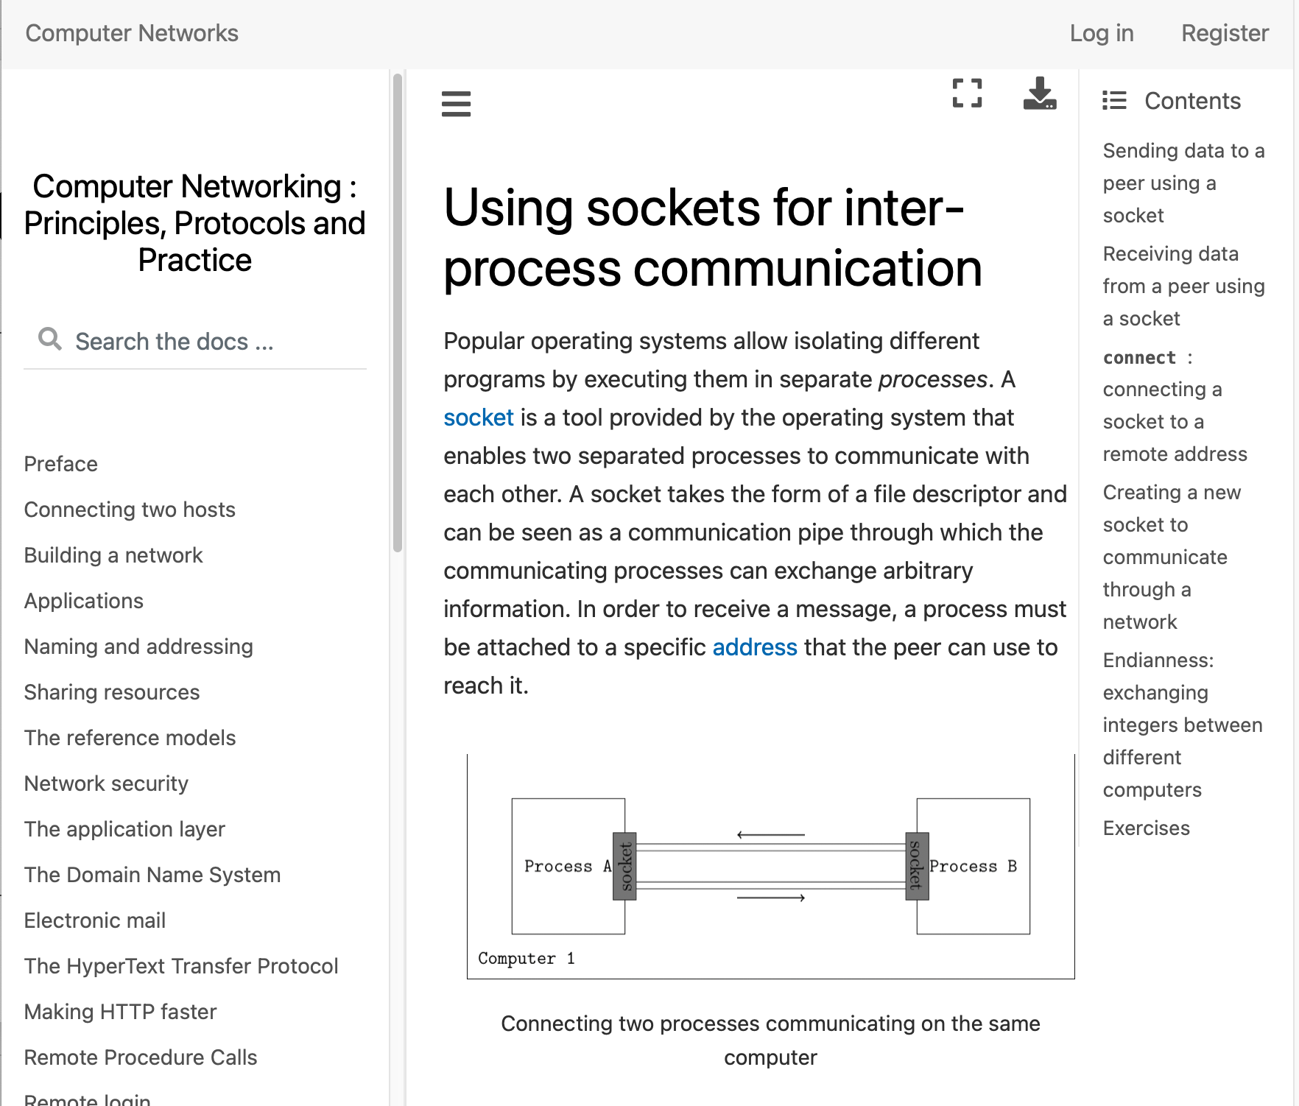
Practical session sockets programming

Slide 145
For next week
Read the sections covered today
Applications, Transport Service
Application Layer
DNS, Email, HTTP
Prepare next week’s topic
Making HTTP faster
Security

